Slide 1
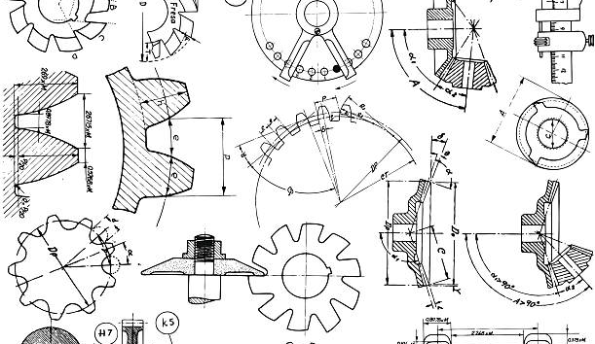
CEIS 308 Final Project
Project Plan for Electric Toothbrush
Ashley johnson

Slide 2
Introduction
This project will challenge you to apply the fundamental skills of computer-assisted design (CAD) to create a 3D model of an electric toothbrush using Autodesk Inventor. Throughout the course, you will progress through the key modules, starting with the creation of 2D drawings, moving into 3D modeling and editing, and culminating in the design of a fully functional electric toothbrush assembly.
By the end of this project, you will demonstrate your ability to:
Create basic 2D CAD drawings utilizing fundamental design principles.
Apply advanced 3D modeling techniques to construct the key components of the toothbrush, such as the handle, brush head, and internal mechanisms.
Leverage pattern tools and assembly features to efficiently build a complete 3D model of the electric toothbrush.
Integrate advanced assembly constraints to ensure the proper functionality and movement of the toothbrush's components.
Apply 3D printing design rules to optimize the model for potential fabrication.
Showcase your mastery of Inventor by designing a visually appealing and ergonomic electric toothbrush that meets all necessary requirements.
This project will not only help you develop strong CAD skills but will also challenge you to think critically about product design, user experience, and manufacturing considerations.

Slide 3
Autodesk Inventor
Part 1

Slide 4
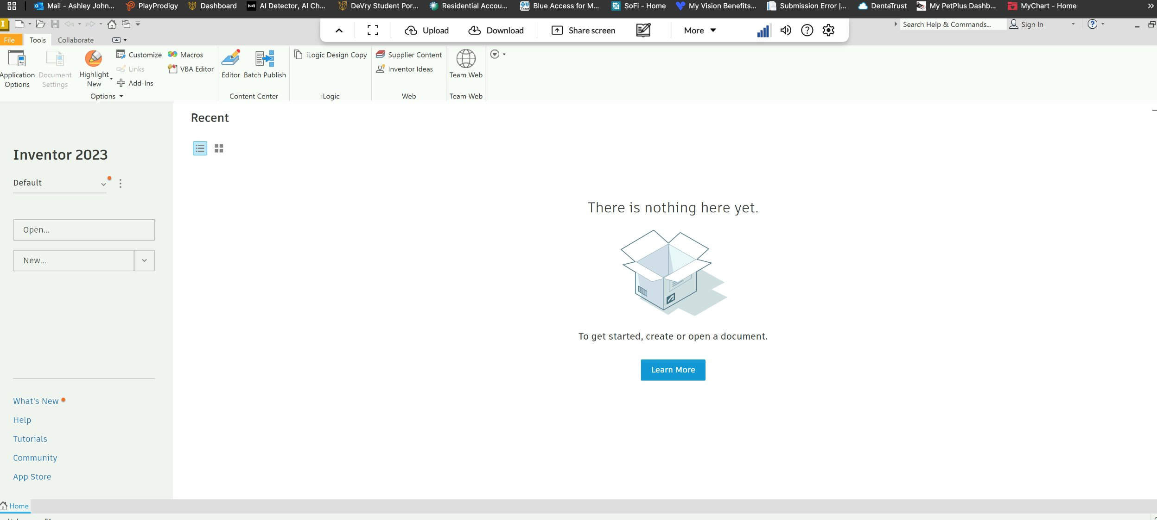
Accessing Software (Include Screenshot)

Slide 5
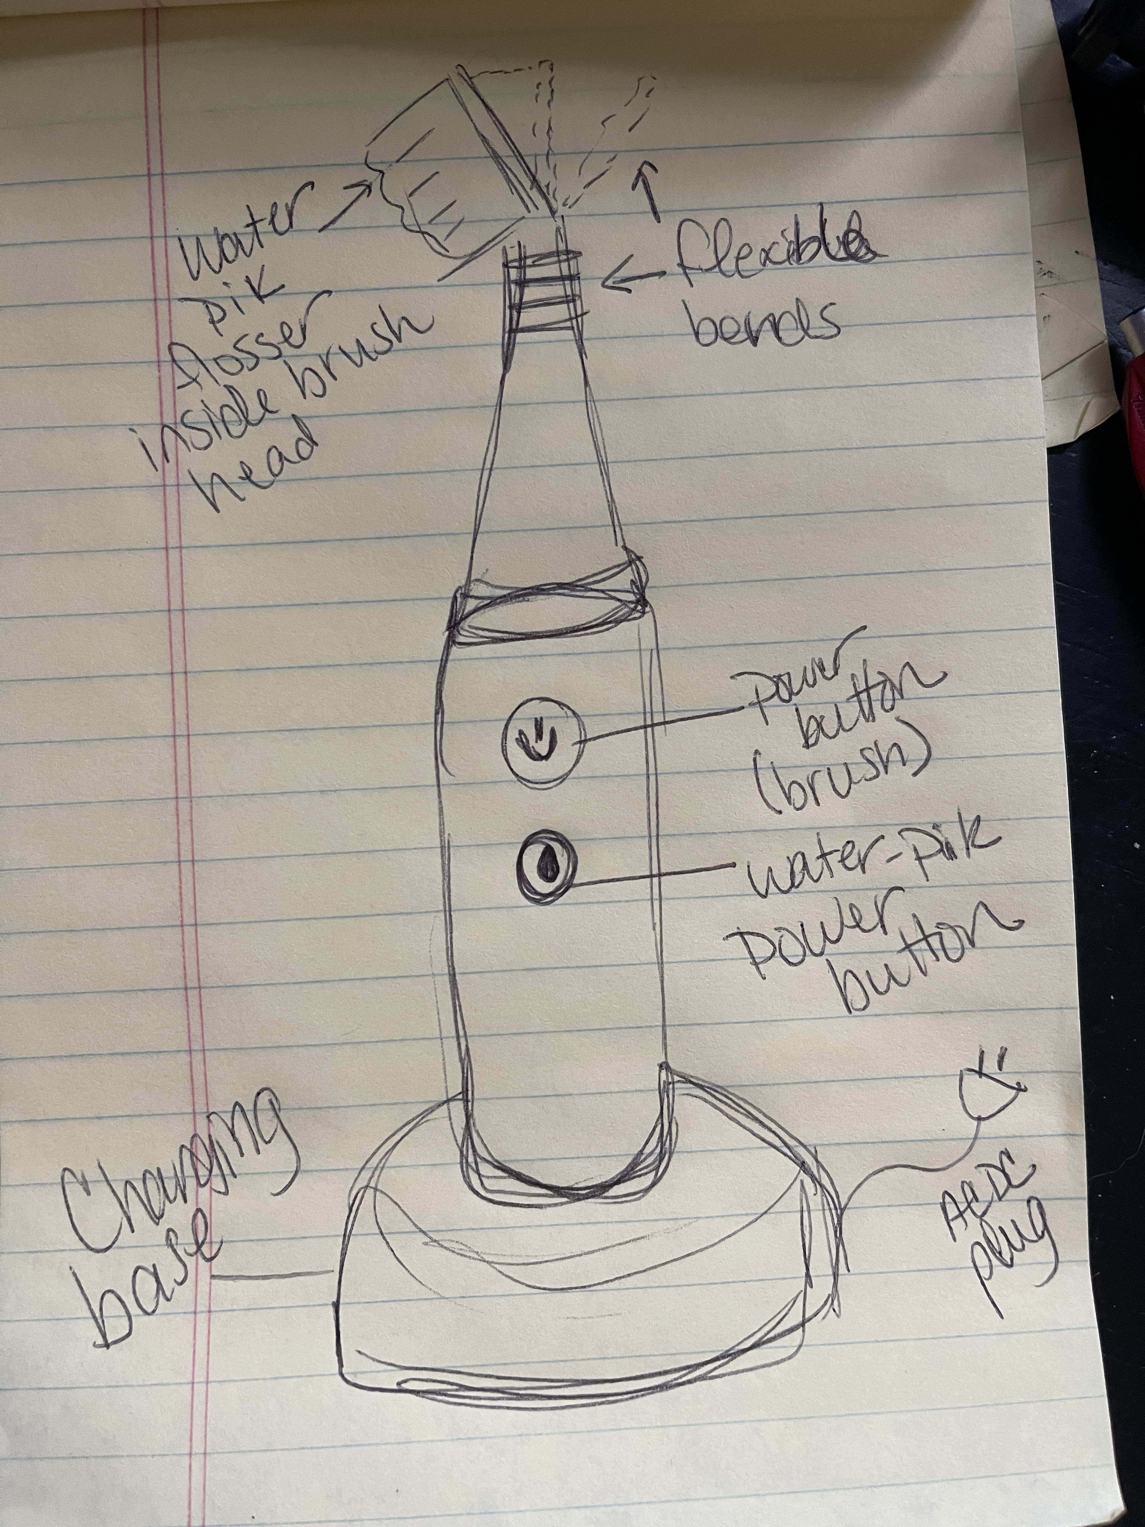
Preliminary Design. Hand-sketched Design

Slide 6
From The Base & Up
Electric Toothbrush Charging Base

Slide 7
Screenshot of Project File Selection
Provide a screenshot of project file for the course project selected on the Home screen.

Slide 8
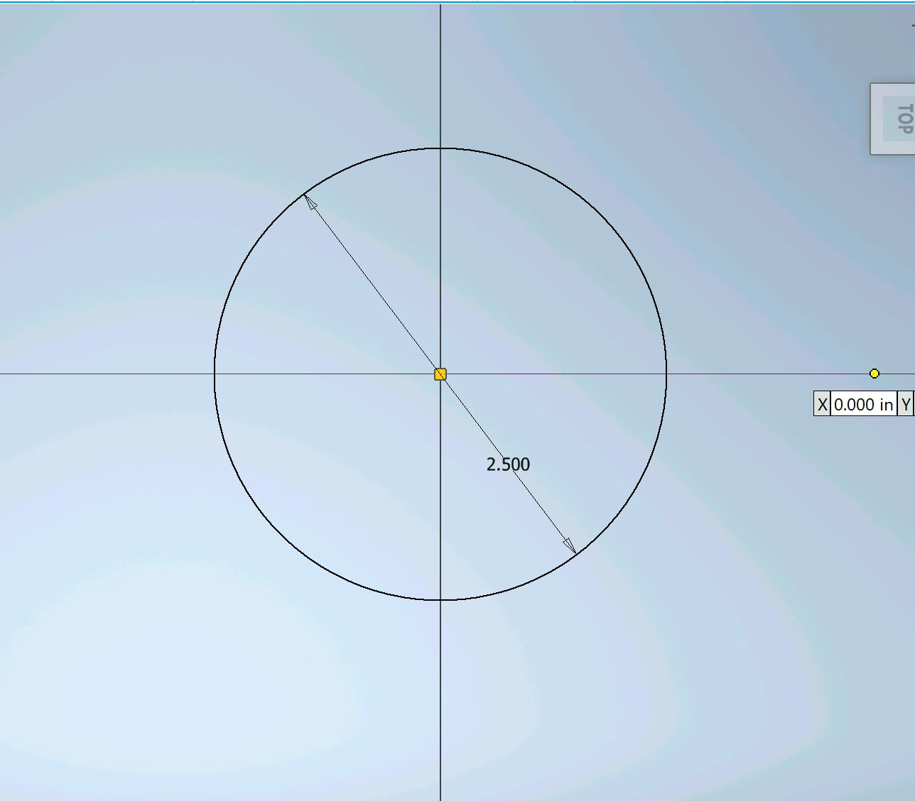
Screenshot of 2-D Sketch
Provide a screenshot of the 2-D sketch of the bottom profile of the toothbrush charging base.

Slide 9
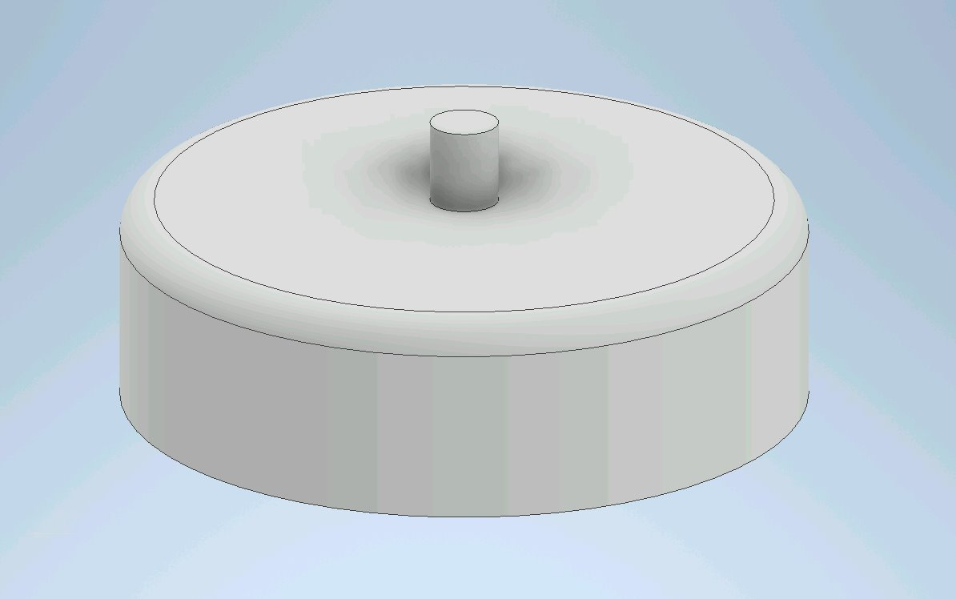
Screenshot of 3-D Sketch

Slide 10
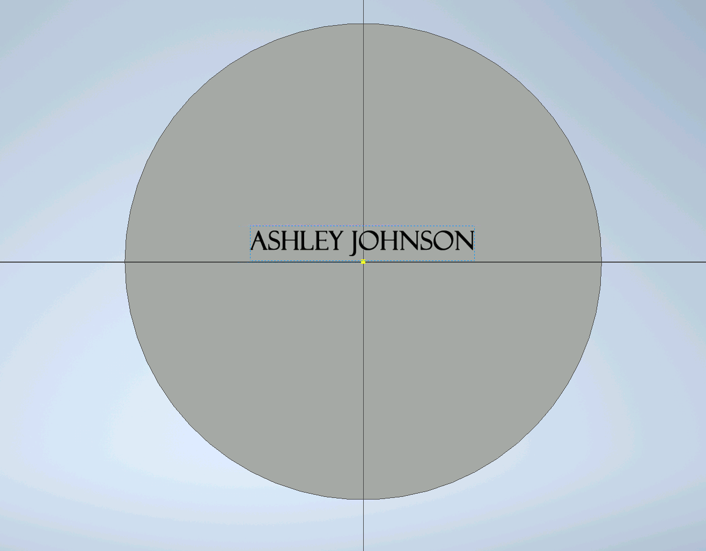
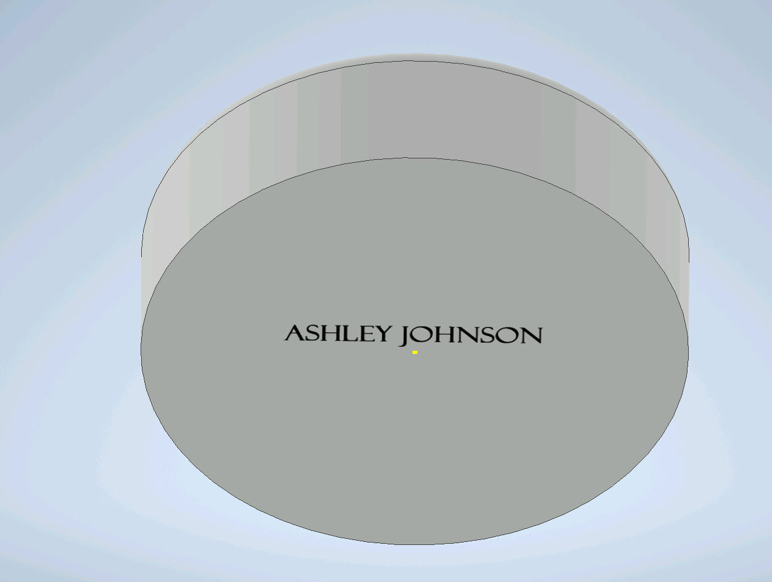
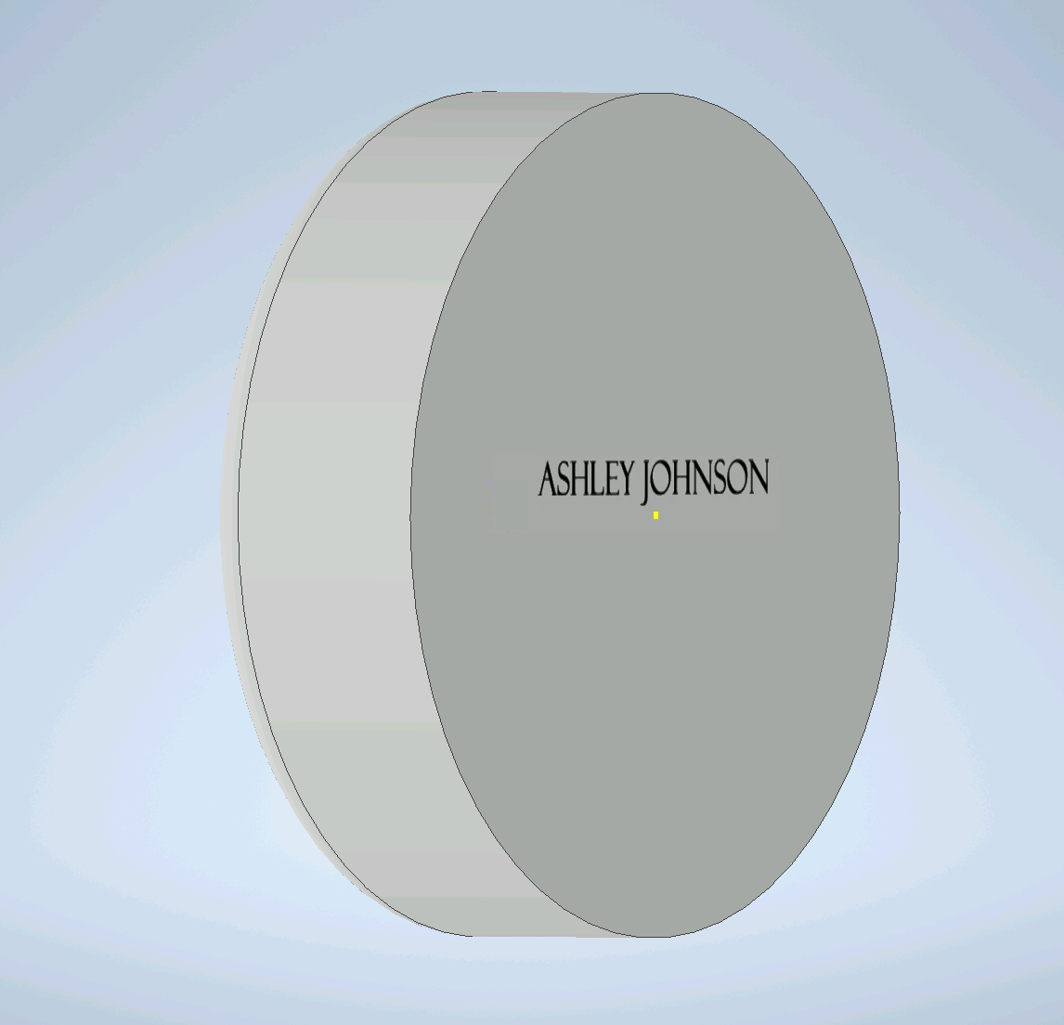
Screenshot of Name on Charging Base

Slide 11
The Handle
Electric Toothbrush Handle

Slide 12
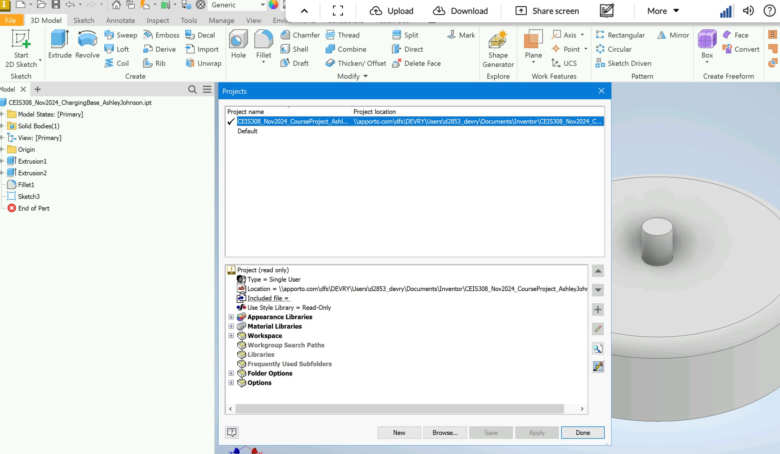
Selecting the Project File

Slide 13
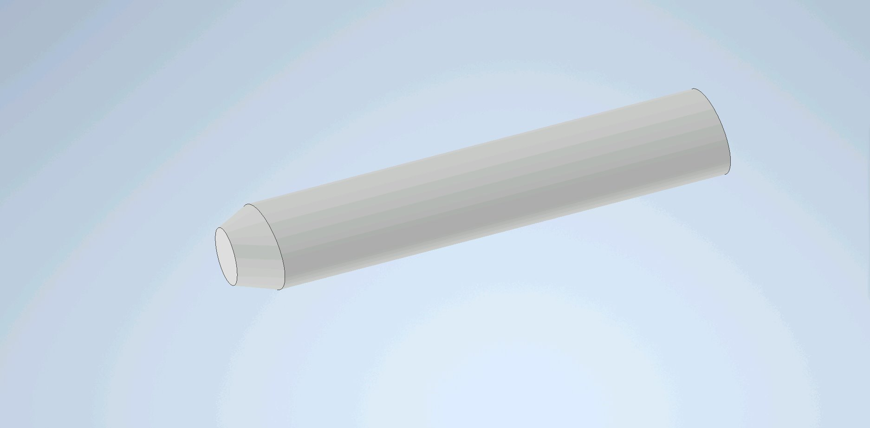
Basic 3-D Shape of the Toothbrush Handle

Slide 14
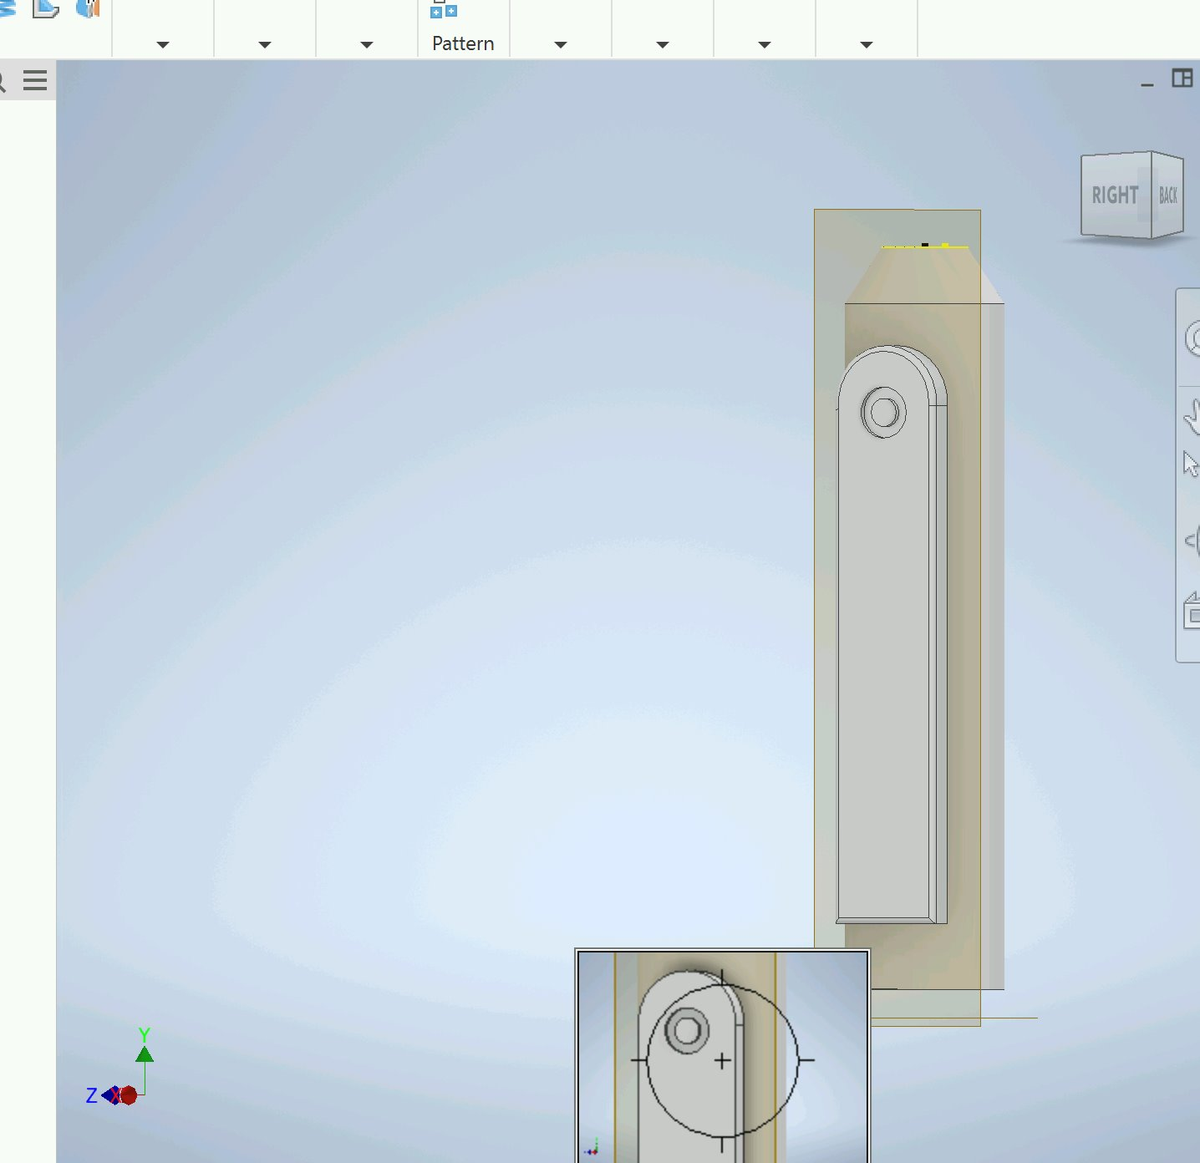
Detailed 3-D Design of the Toothbrush Handle

Slide 15
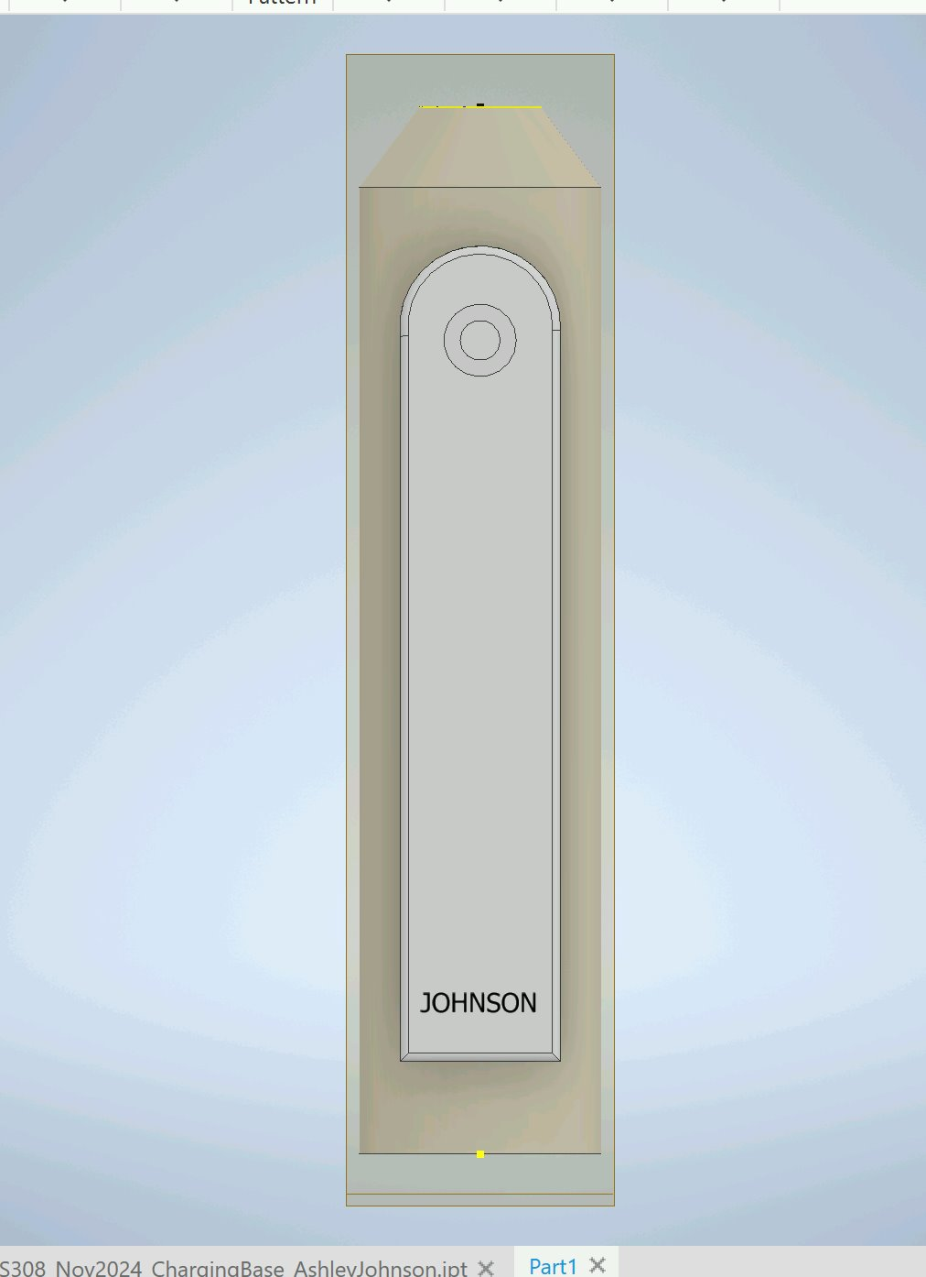
Name on the 3-D Part

Slide 16
The Head: Part 1 of 2
Electric Toothbrush Head- Part 1

Slide 17
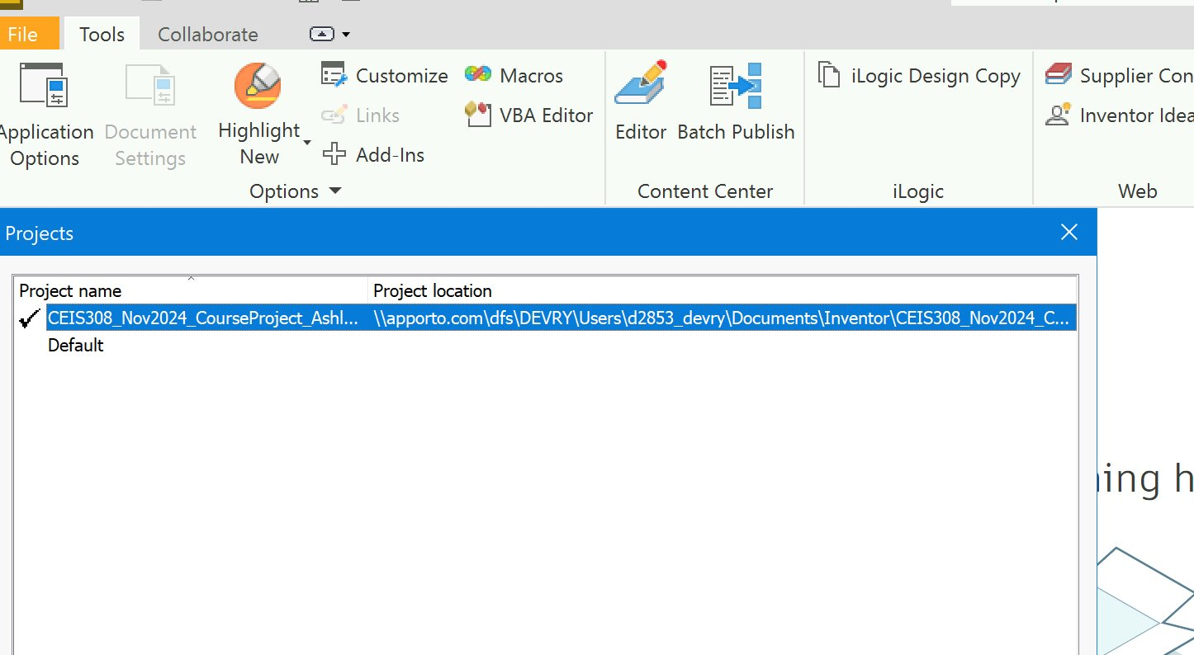
Selecting the Project File

Slide 18
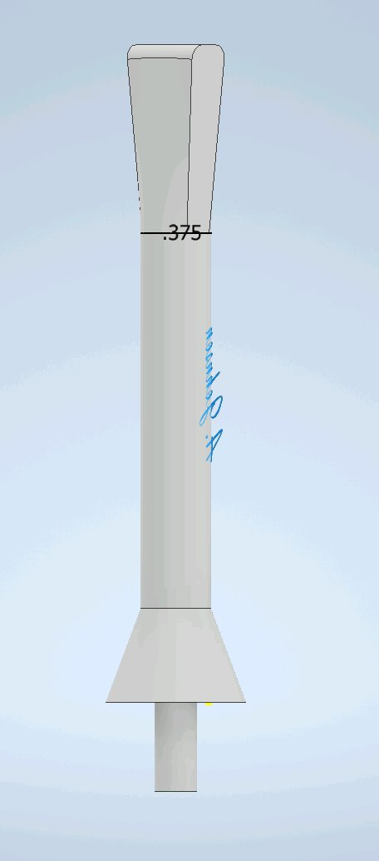
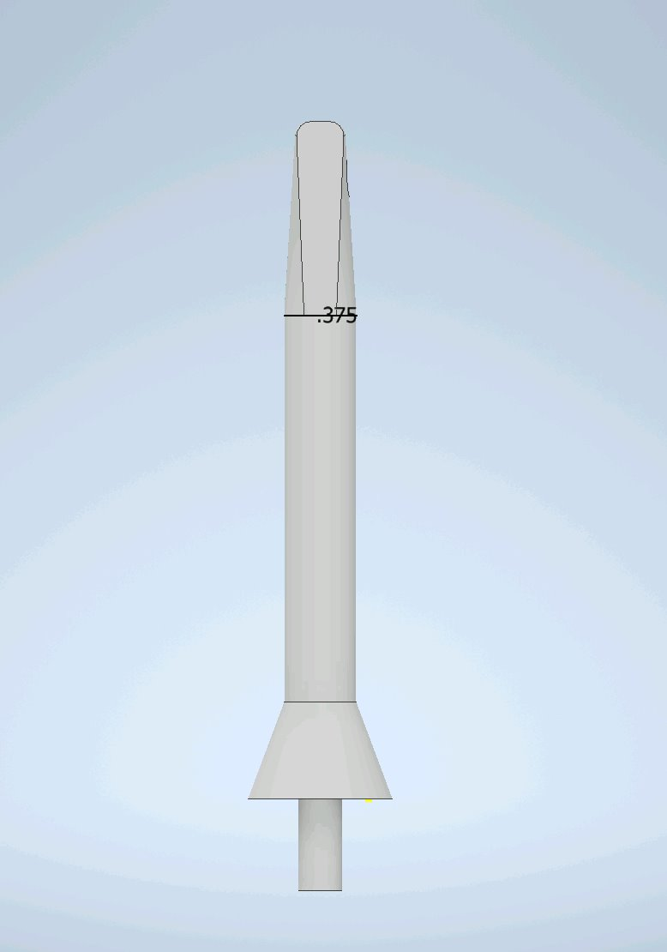
Basic 3-D Shape of the Ridged Toothbrush Head

Slide 19
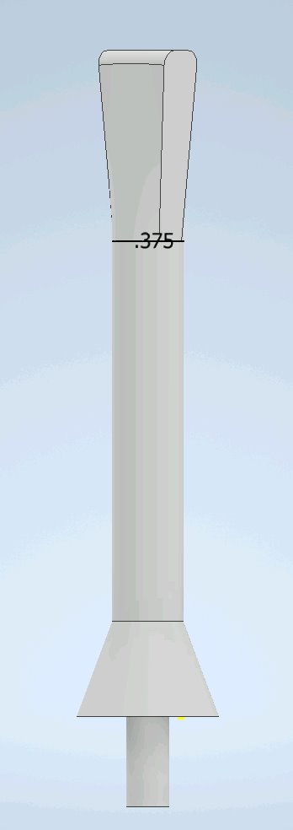
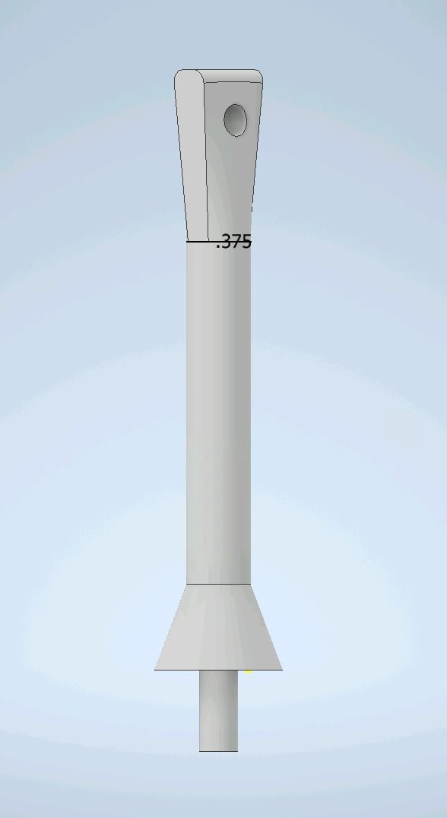
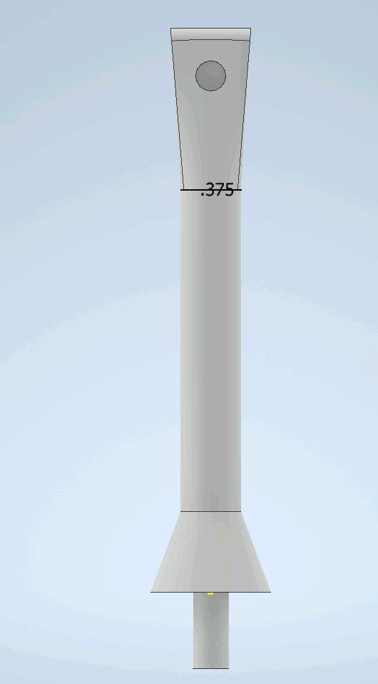
Detailed 3-D Design of the Ridged Toothbrush Head

Slide 20
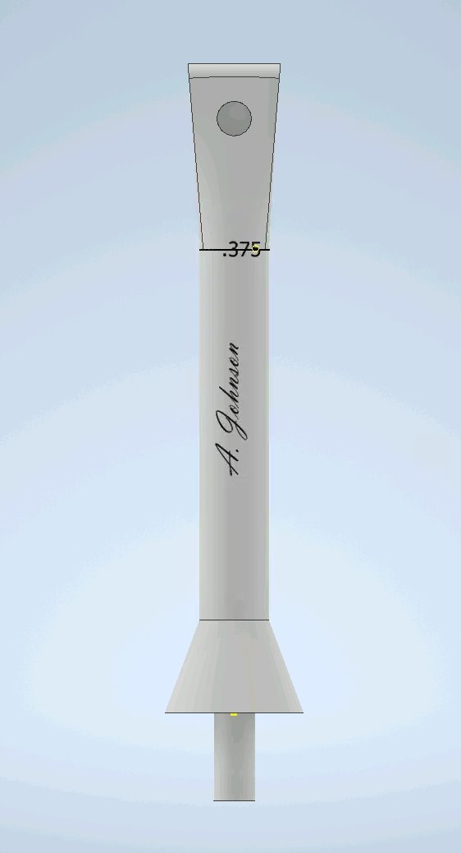
Adding Name to the 3-D Part

Slide 21
The Head: Part 2
Electric Toothbrush Head- Part 2

Slide 22
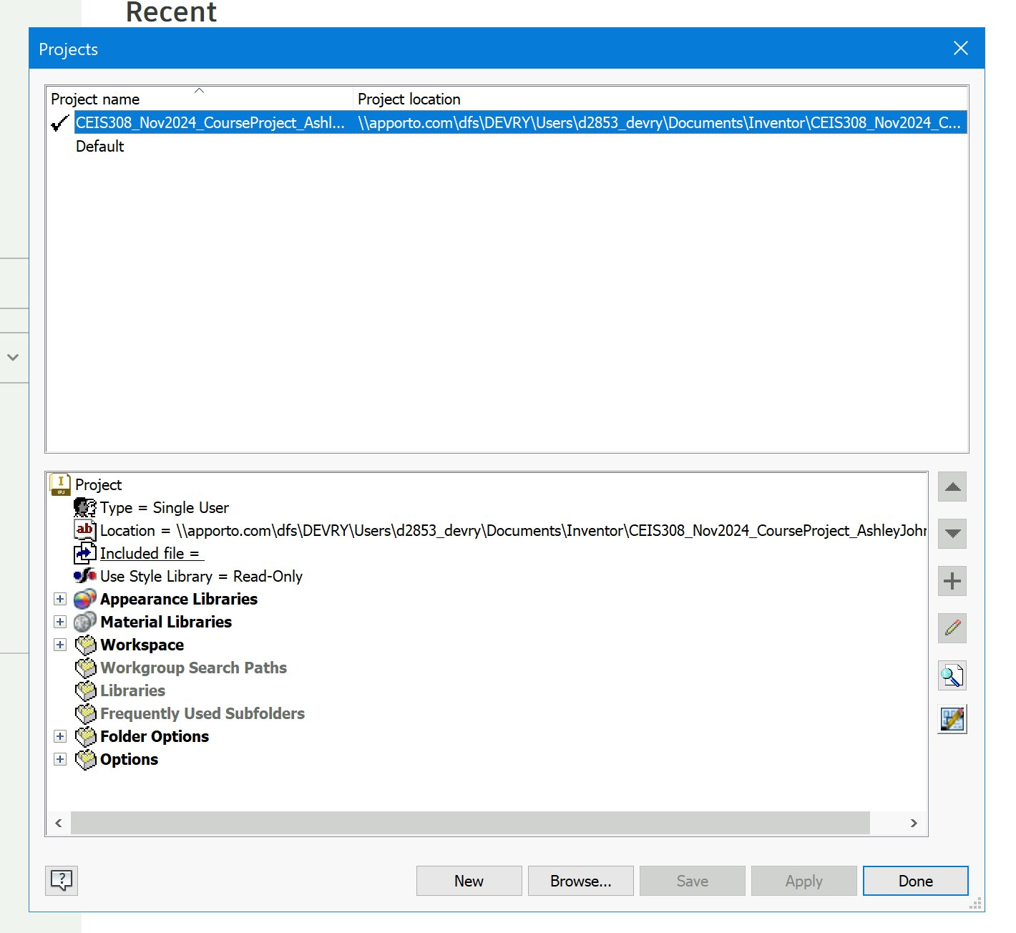
Selecting the Project File

Slide 23
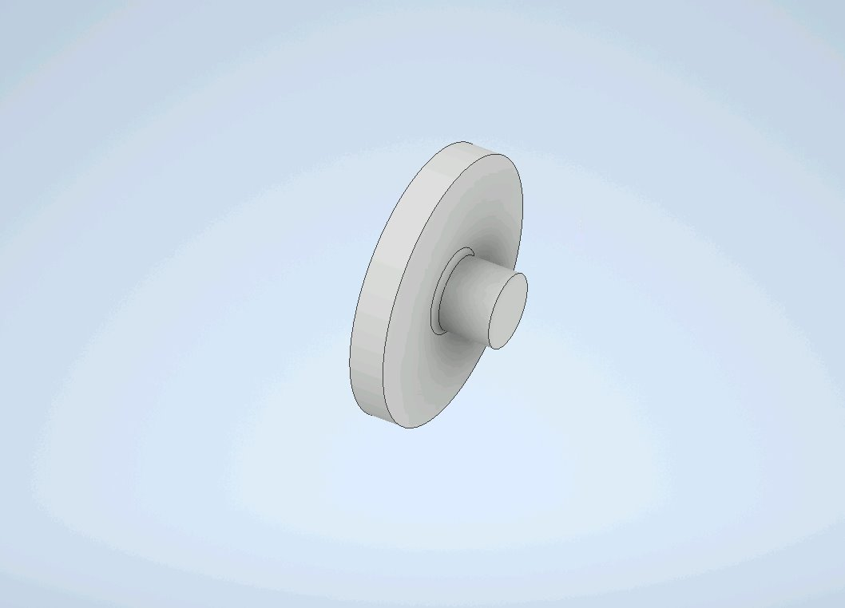
Basic 3-D Shape of the Toothbrush Head without Bristles

Slide 24
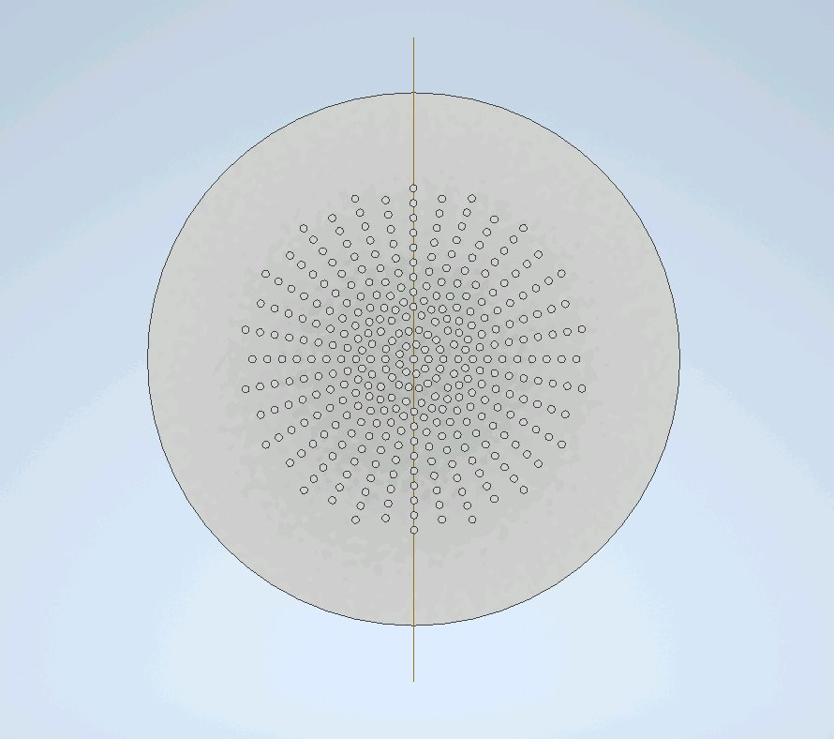
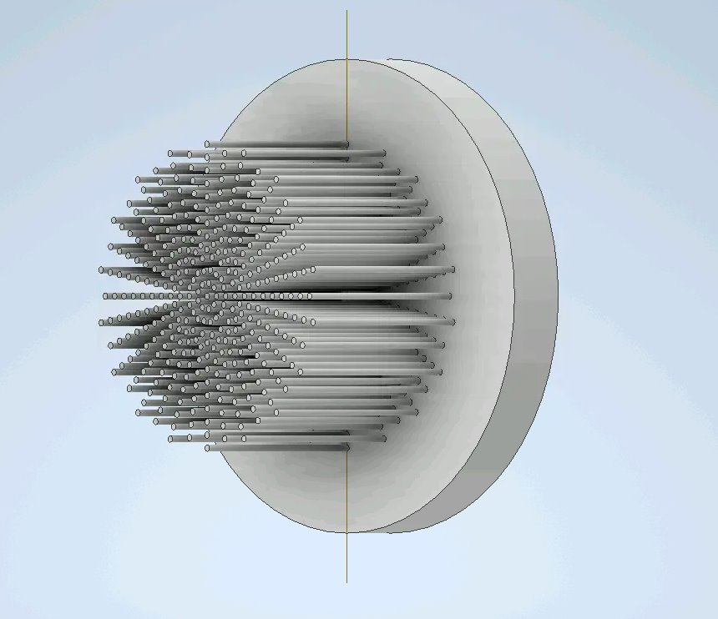
Detailed 3-D Design of the Toothbrush Head with Bristles

Slide 25
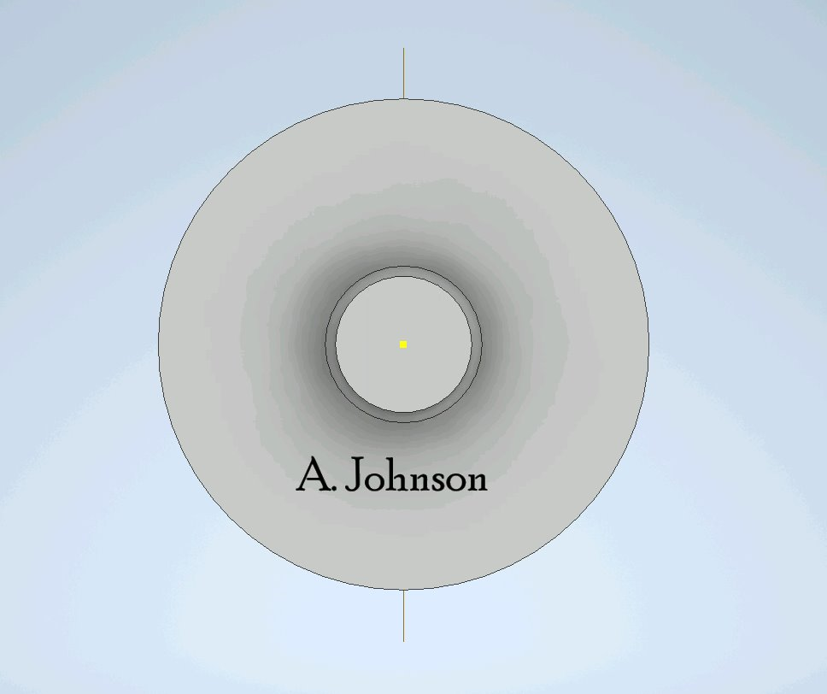
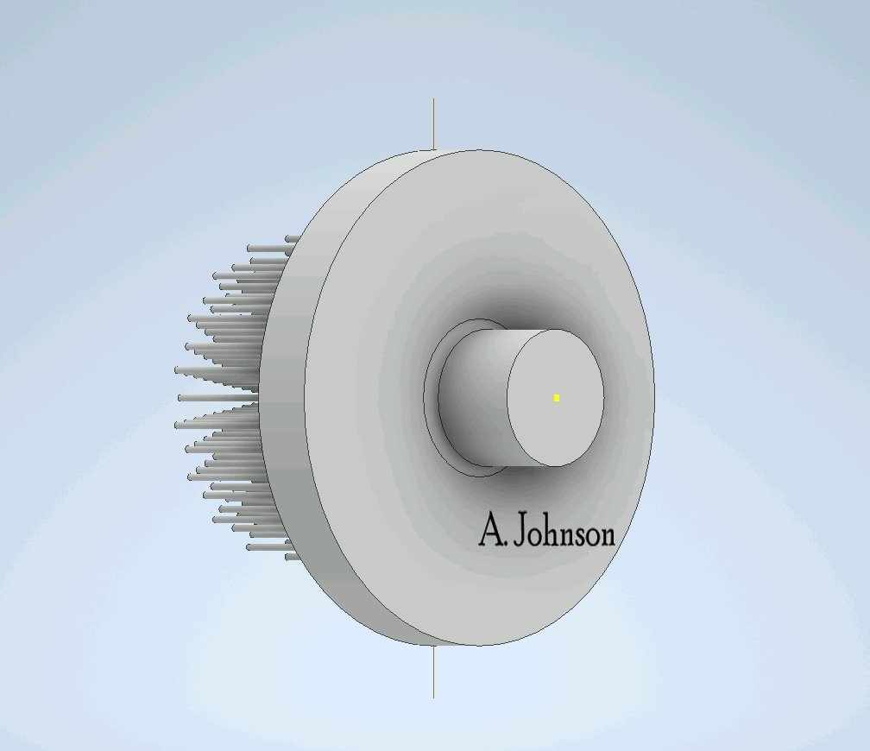
Adding My Name to the 3-D Part

Slide 26
All Together Now...
Electric Toothbrush Assembly

Slide 27
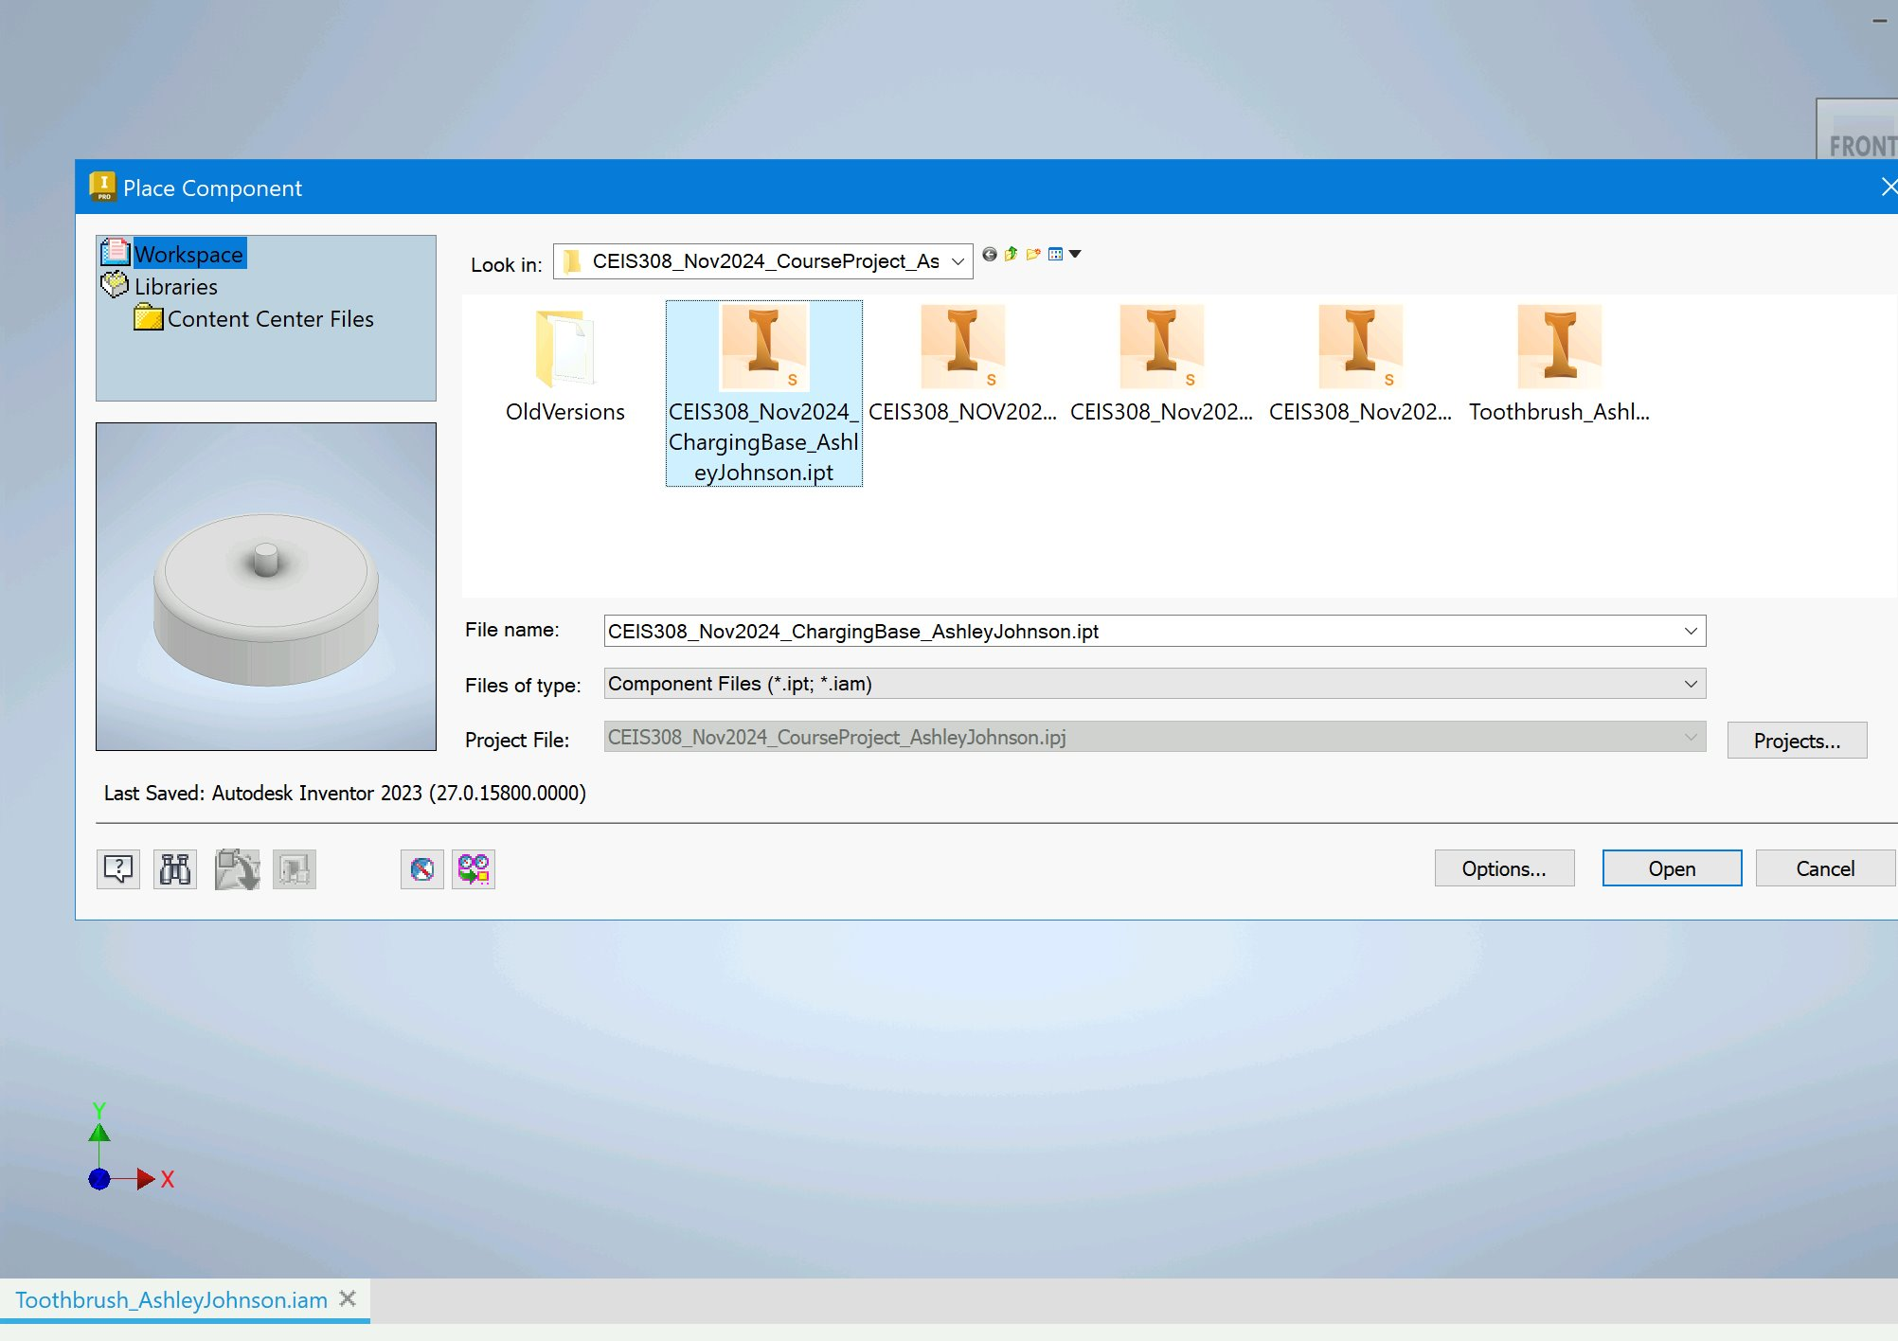
Place Component Window

Slide 28
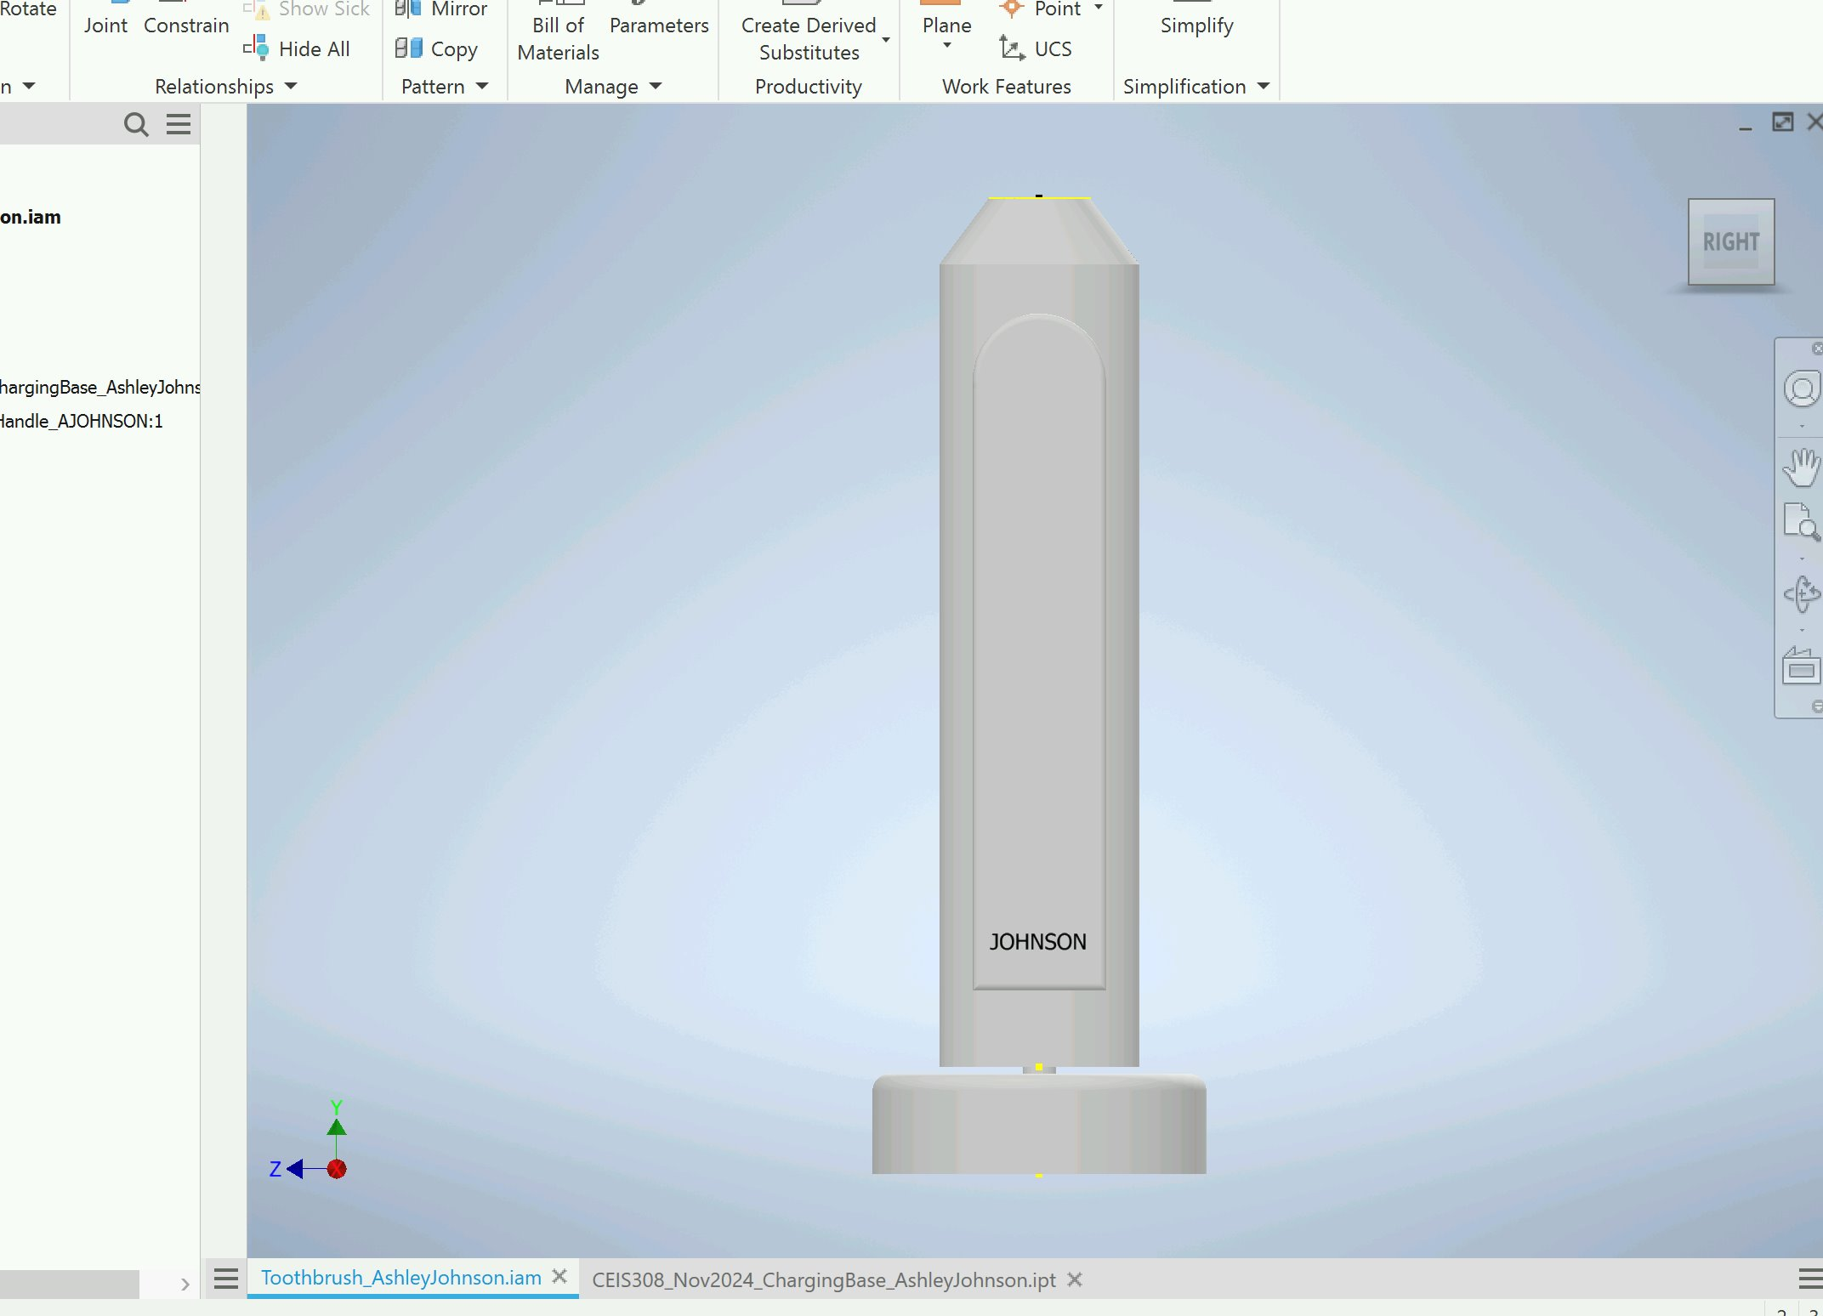
Charging Base and the Toothbrush Handle

Slide 29
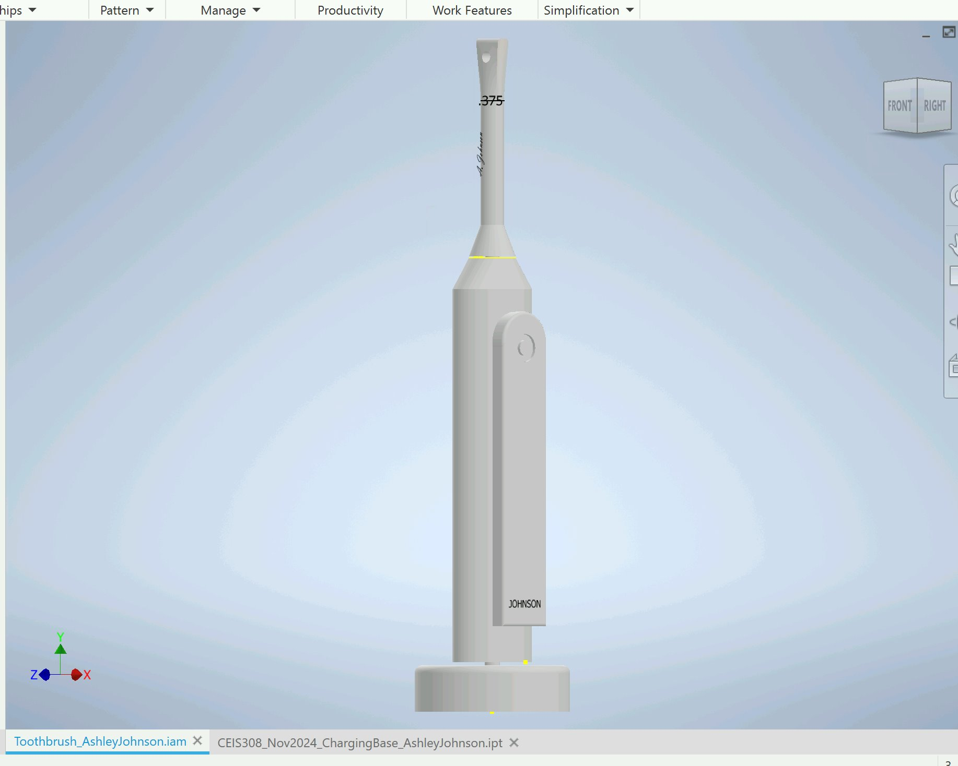
Toothbrush Handle and Ridged head

Slide 30
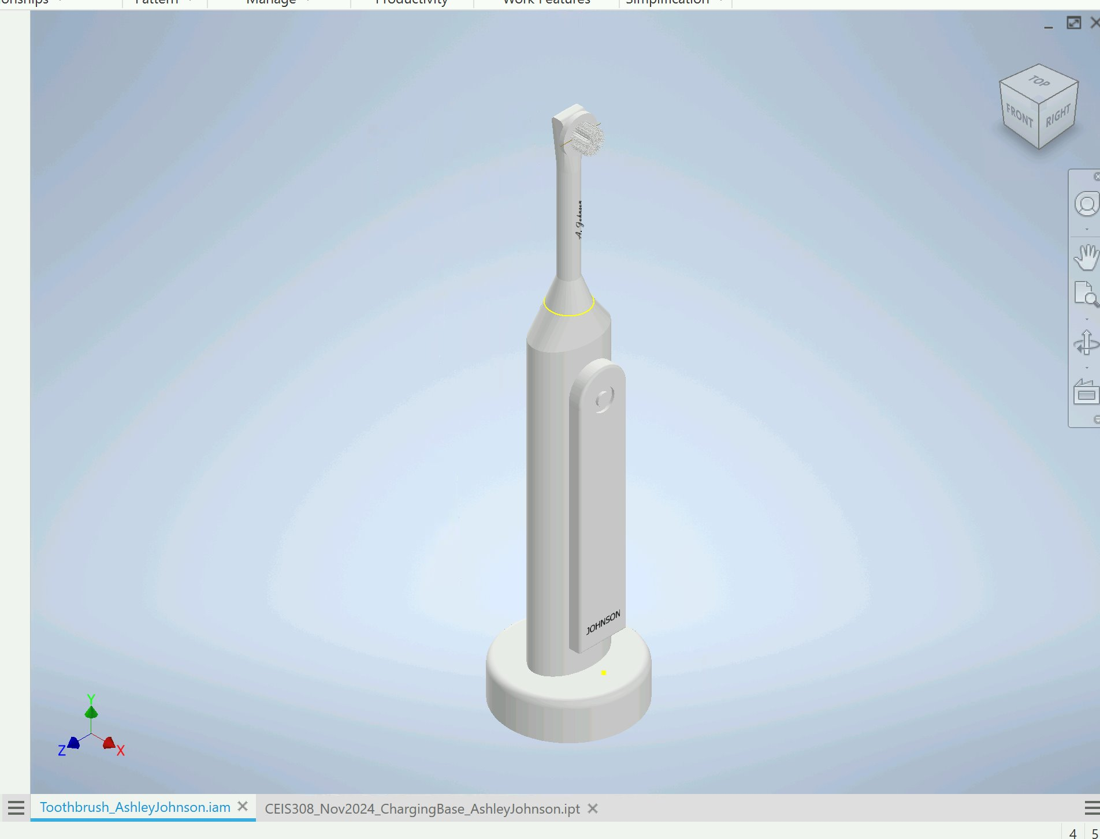
Complete Assembly

Slide 31
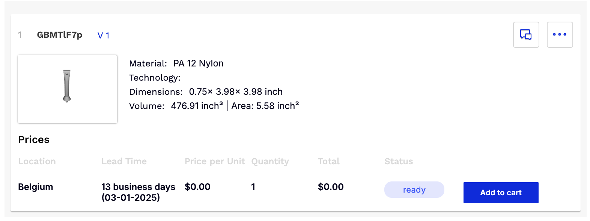
Printed Prototype Quote

Slide 32
Career Skills Obtained
1. Computer-Aided Design (CAD) Proficiency:
Mastery of 2D and 3D CAD software, specifically Autodesk Inventor
Ability to create detailed technical drawings and 3D models
Understanding of design principles and best practices in CAD
2. 3D Modeling and Visualization:
Expertise in constructing 3D models using advanced modeling techniques
Skill in manipulating and editing 3D shapes and components
Competence in visualizing and presenting 3D designs
3. Assembly and Constraint Modeling:
Ability to build complex assemblies by integrating multiple components
Understanding of assembly constraints and their application to ensure proper functionality
Experience in designing moving parts and mechanisms within a 3D model
4. Product Design and Development:
Consideration of user experience, ergonomics, and aesthetics in product design
Understanding of manufacturing processes and design-for-manufacturing principles
Ability to iterate on designs and optimize for specific requirements
5. 3D Printing and Additive Manufacturing:
Knowledge of 3D printing design rules and considerations
Skill in preparing 3D models for potential fabrication using additive manufacturing techniques
6. Problem-Solving and Critical Thinking:
Ability to approach design challenges systematically and creatively
Development of analytical and decision-making skills
Experience in identifying and addressing design constraints and requirements
These skills are highly valued in various industries, including product design, engineering, manufacturing, and industrial design. The hands-on experience gained through this project can prepare students for careers in fields such as mechanical engineering, industrial design, product development, and computer-aided design.

Slide 33
Challenges Overcome
Mastering 2D CAD Fundamentals:
Challenge: Transitioning from traditional drafting to computer-aided 2D drawing techniques.
Overcoming the Challenge: Dedicated practice with Inventor's 2D drawing tools, understanding best practices for dimensioning, and seeking guidance from tutorials or instructor support.
Navigating 3D Modeling and Editing Tools:
Challenge: Adapting to the complexity of 3D modeling and managing multiple components.
Overcoming the Challenge: Systematic exploration of Inventor's 3D modeling features, understanding the importance of sketching and feature-based modeling, and seeking hands-on practice with 3D modeling exercises.
Applying Patterns and Advanced 3D Modeling Techniques:
Challenge: Efficiently creating and replicating complex 3D features and components.
Overcoming the Challenge: Familiarizing oneself with pattern tools, understanding the concept of parametric modeling, and practicing the application of these techniques on various 3D modeling projects.
Designing a Visually Appealing and Ergonomic 3D Model:
Challenge: Balancing technical requirements with aesthetic
Overcoming the Challenge: Gathering research from images and personal experience to understand ergonomic needs, design principles for the product aesthetics, and iterating on the 3D model to achieve a visually appealing and ergonomic design. Feedback from peers also helped to refine the design.

Slide 34
Conclusion
This electric toothbrush design project in Autodesk Inventor has been a comprehensive learning experience that has allowed me to fully apply the course objectives and develop a wide range of valuable career skills.
Through the creation of 2D drawings, 3D modeling, assembly design, and adherence to 3D printing guidelines, I have demonstrated my proficiency in computer-aided design and problem-solving. The hands-on nature of this project has challenged me to navigate the complexities of 3D modeling, manage organizational structures, and balance technical requirements with aesthetic considerations.
Along the way, I have encountered obstacles such as mastering 2D and 3D CAD tools, implementing advanced assembly functions, and ensuring the design is optimized for potential fabrication. However, by actively seeking guidance, practicing consistently, and leveraging the resources provided, I have overcome these challenges and developed a comprehensive understanding of the design process.
This project has not only strengthened my technical skills but has also honed my critical thinking, creativity, and attention to detail – all of which are highly sought-after in various industries, from product design and engineering to manufacturing and industrial design.
With the knowledge and experience gained, I am now better-equipped to tackle future design challenges and contribute to the development of innovative products that improve the quality of life for users.

