Slide 1
CEIS110: Introduction to Programming
Final Project
Ashley Johnson

Slide 2
Introduction
Data plays a critical role in a wide range of applications and industries.
This project utilizes a cloud-based system for the collection of temperature and humidity data.
The data is processed and evaluated through programming and data analytics techniques.

Slide 3
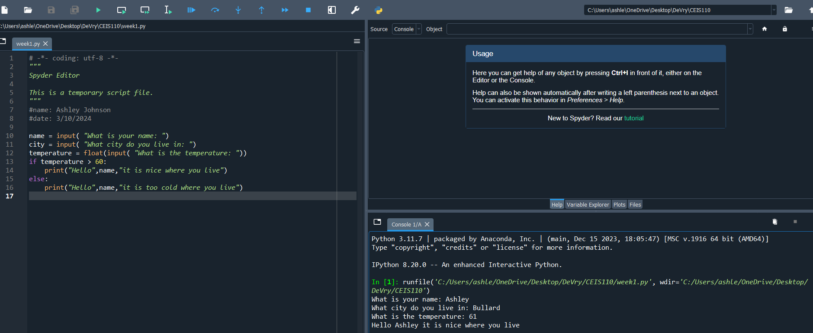
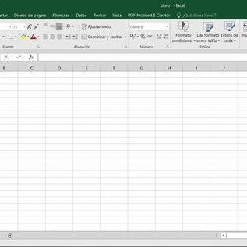
Software Inventory
Prior to starting this programming with data project, all software must be downloaded and installed.
Software needed: Spyder, Excel and Python.

Slide 4
Planning and Design
Following a software inventory, a plan was devised for the temperature data project.
A flowchart was created to outline the project design.
Planning and designing the project are essential steps in comprehending the development process.

Slide 5
What are Flowcharts?
A flowchart is a visual representation of a process, showing the steps involved and the sequence in which they occur.
Flowcharts are crucial for illustrating the design and structure of the project, outlining the various stages, inputs, outputs, and decision points. They provide a clear and concise overview of the process, helping to identify potential bottlenecks, errors, or areas for improvement.
By visually mapping out the workflow, a flowchart enhances communication among team members and stakeholders, ensuring a common understanding of the project objectives and requirements.

Slide 6
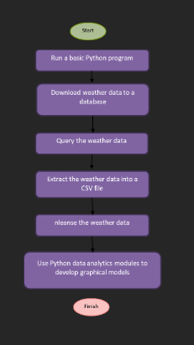
Flowchart
Include the following processes:
Run a basic python program
Download weather data to a database.
Query the weather data
Extract weather data from database into a comma separated file with python
Cleanse weather data
Use python data analytics modules to develop graphical models

Slide 7
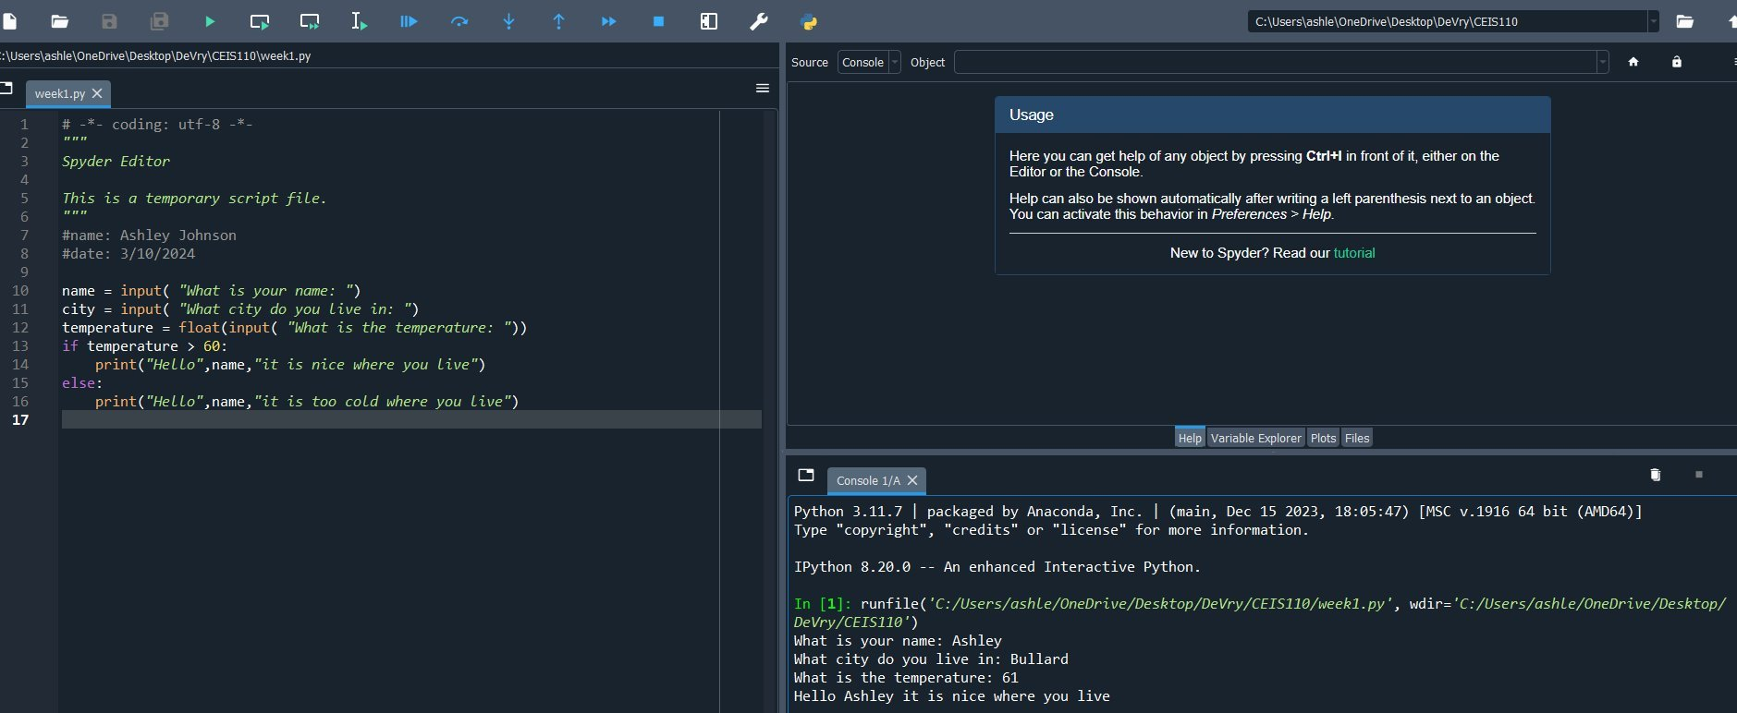
Python...(Screenshot)
Python is a versatile and powerful programming language widely used for various applications, including web development, data analysis, artificial intelligence, and scientific computing.
It is favored for its simplicity and readability, making it accessible for both beginners and experienced programmers. Python's extensive library of tools and frameworks enables developers to efficiently build and deploy applications, automate tasks, and solve complex problems. Its flexibility and robustness make it a popular choice for businesses and organizations seeking to streamline processes, analyze data, and create innovative solutions.
In essence, Python is a versatile tool that empowers developers to create efficient and effective software solutions across a wide range of industries and disciplines.

Slide 8
Gathering Temperature and Humidity Data
Following the planning and design phase, the code was created to retrieve a specific set of weather observations for the designated area.
The collected data was then stored in a local database table for future analysis.
Utilizing Spyder for the code, the execution demonstrated a successful running of the Python program.
The database file was generated and saved for seamless retrieval within Python.

Slide 9
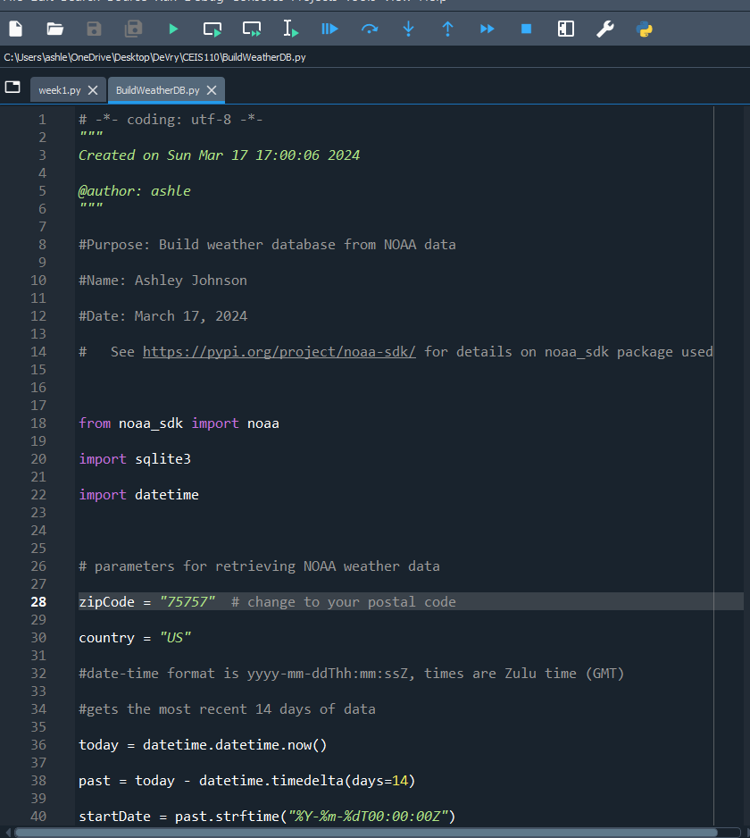
BuildWeatherDb.py Code (Screenshot)
Screenshot of code in Spyder
The code will create a table named Observations with the fields: timestamp, wind speed, temperature, relative humidity, wind direction, barometric pressure, visibility, and text description.
The database will be named weather.db and stored in the same directory as the Python code.

Slide 10
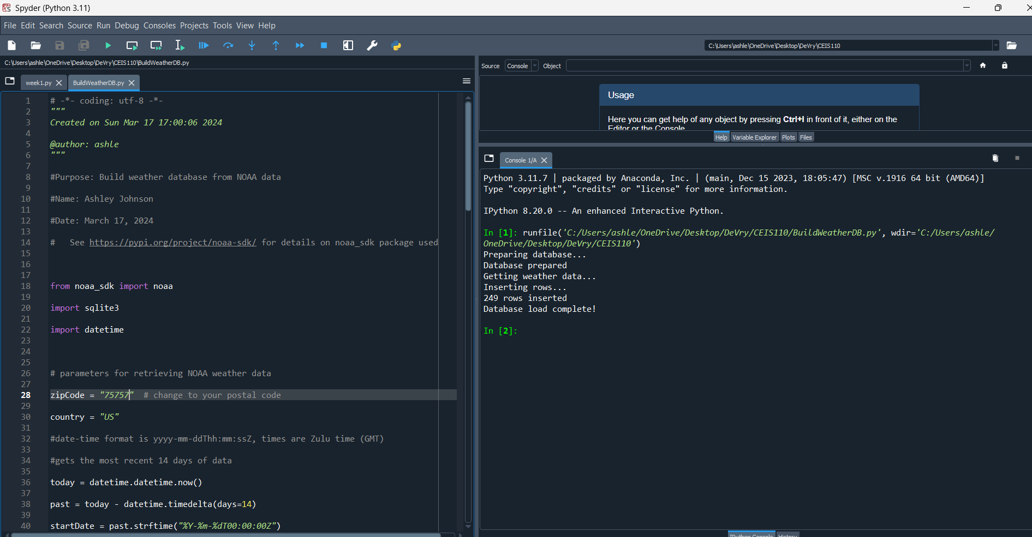
Python Console (Screenshot)
Screenshot of program output in Python console showing program executed successfully

Slide 11
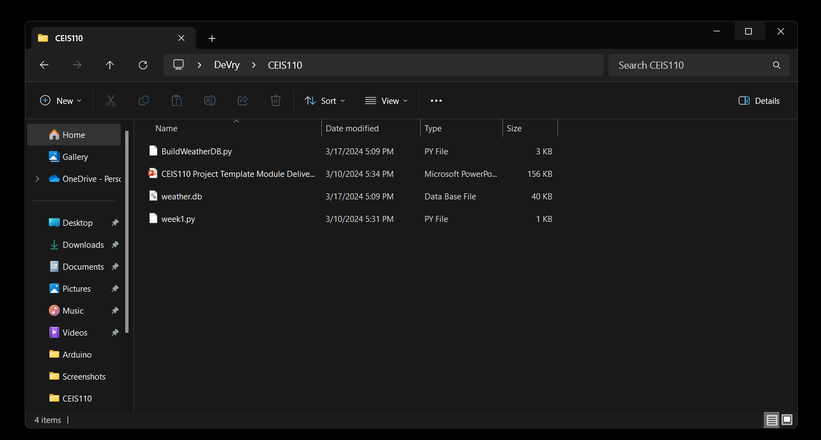
Weather.db File (Screenshot)
Screenshot of Windows Explorer showing database file Weather.db was created

Slide 12
Querying the Database with SQL
Structured Query Language (SQL) is a standardized programming language used to manage and manipulate data stored in relational databases. In the context of this project, SQL plays a crucial role in interacting with the local database where the weather observations are stored.
SQL queries are utilized to retrieve, insert, update, and delete data in the database, enabling efficient data management and analysis. By leveraging SQL commands, the Python program can interact with the database, extract relevant information, and perform various operations on the stored data.
SQL acts as a bridge between the application and the database, facilitating seamless communication and data handling in the project.

Slide 13
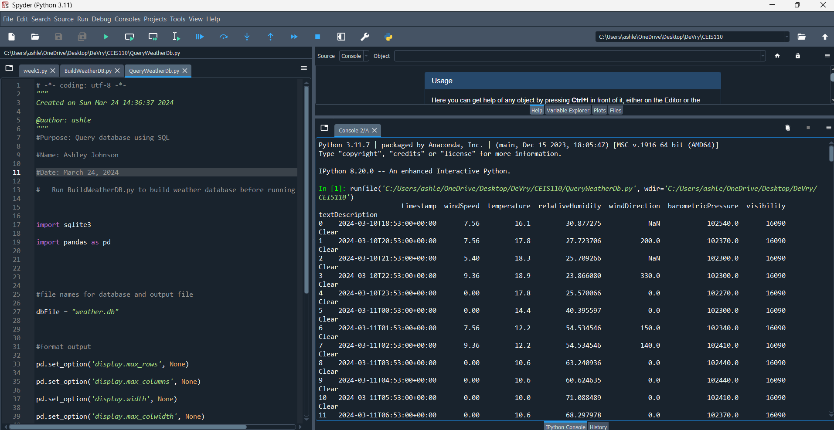
Query to retrieve all columns and all rows (Screenshot)
Screenshot of SQL query command and results

Slide 14
Query to retrieve lowest and highest temperatures (Screenshot)
Screenshot of SQL query command and results

Slide 15
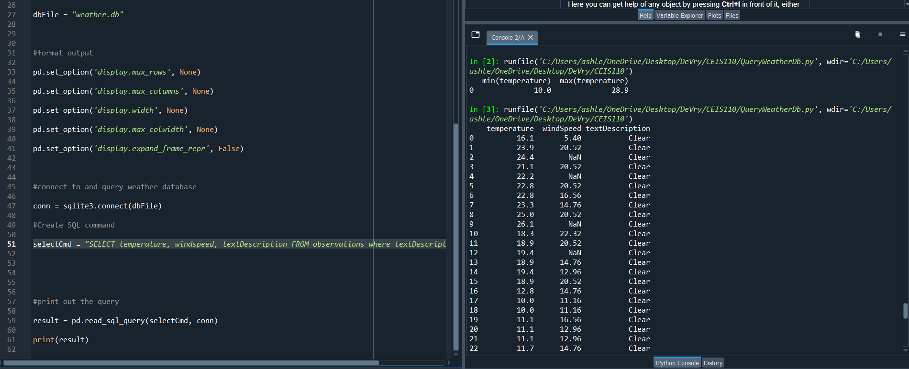
Query to retrieve all clear days (Screenshot)
Screenshot of SQL query command and results

Slide 16
Data Cleansing - Querying and manipulating data with SQL and Python
Data cleansing, also known as data cleaning or data scrubbing, is the process of identifying and correcting errors, inconsistencies, and discrepancies in a dataset to ensure its accuracy and reliability.
For this project, data cleansing involves reviewing the weather observations stored in the local database to detect and rectify any inaccuracies, incomplete entries, or anomalies that may impact the quality of the analysis.
By performing data cleansing, the project aims to enhance the integrity and usability of the dataset, enabling more accurate and meaningful insights to be derived from the weather data.
This process helps to improve the overall quality of the data and ensures that any subsequent analysis or modeling is based on reliable and consistent information.

Slide 17
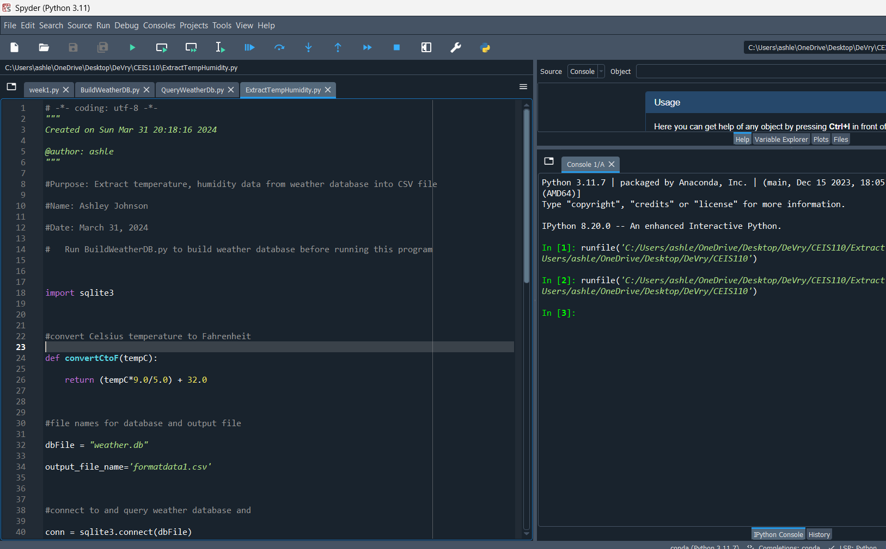
Python code (Screenshot or file)
ExtractTempHumidity.py Python code with your name and date in comments

Slide 18
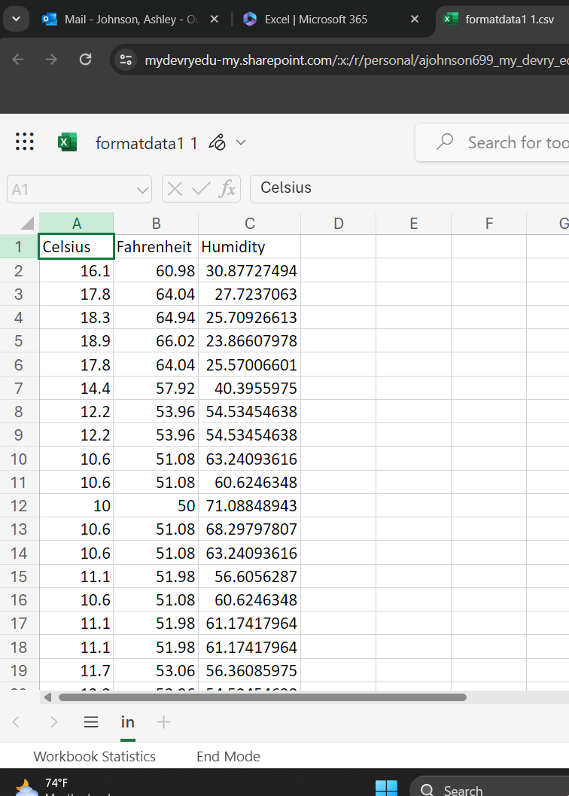
Retrieve and Convert Data to CSV Format (Screenshot)
Formatdata file open in Excel showing 3 columns of data

Slide 19
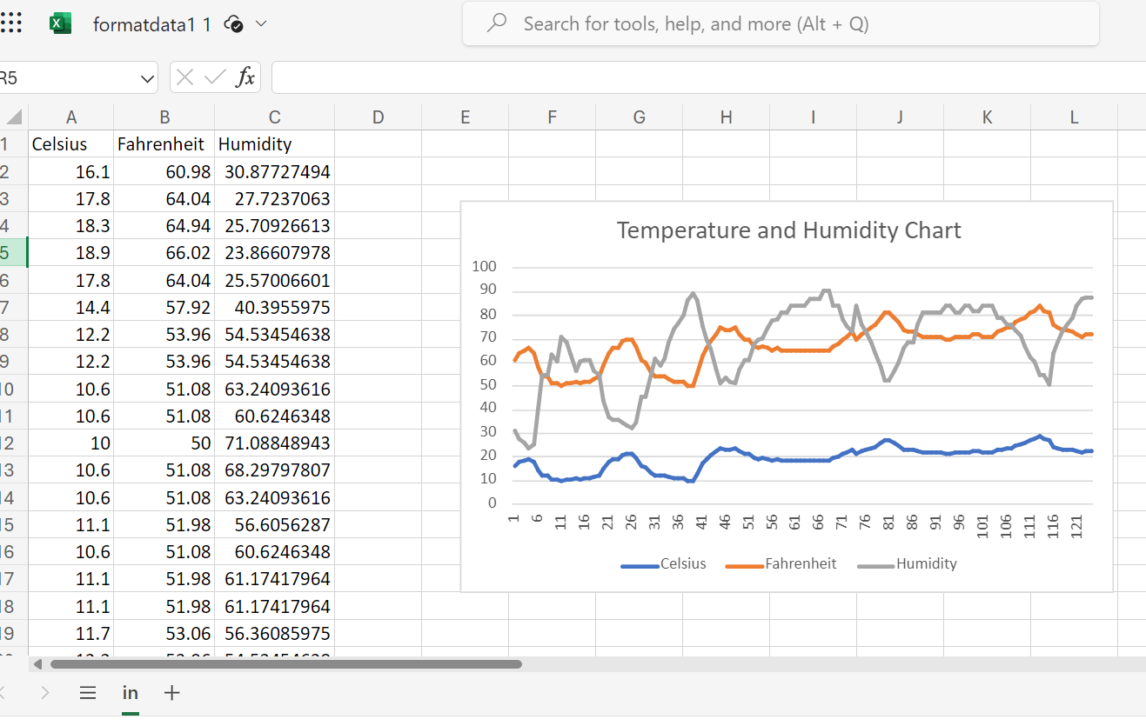
Temperature and Humidity Chart (Graph)
Excel chart based on temperature and humidity data from database

Slide 20
Data Analytics - Develop Graphical Models and Interpret Results
Data analytics is a key component of the project, involving the systematic analysis of the weather observations stored in the local database to extract valuable insights and trends.
Through the use of data visualization techniques such as plots and charts, the project aims to visually represent the data in a clear and informative manner, facilitating a deeper understanding of the weather patterns and trends in the area. By analyzing the historical weather data, the project can identify patterns, correlations, and anomalies that may provide valuable insights for decision-making or future planning.
Overall, data analytics in this project empowers stakeholders to gain meaningful insights from the weather data, make informed decisions, and potentially predict future weather conditions, ultimately enhancing the project's effectiveness and value.

Slide 21
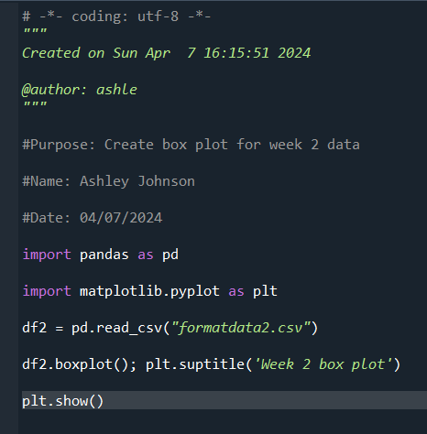
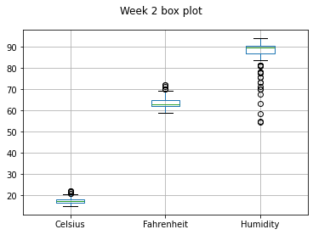
Plot #1
Plot and code used to generate it
Box
Line
Histogram
Scatter

Slide 22
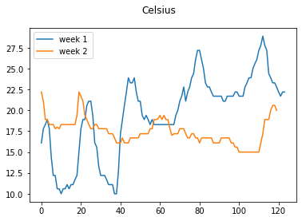
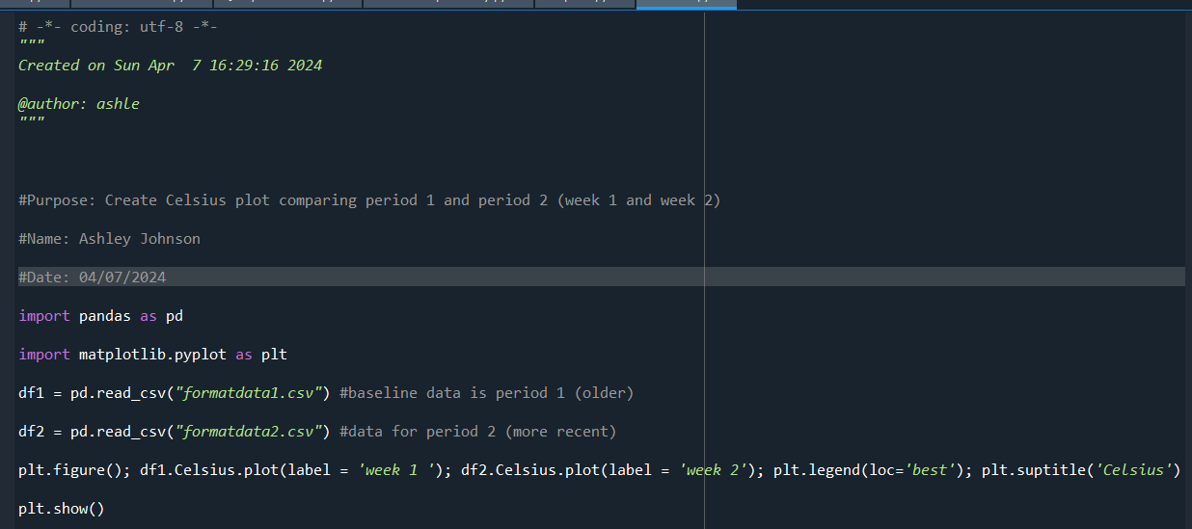
Plot #2
Plot and code used to generate it
Box
Line
Histogram
Scatter

Slide 23
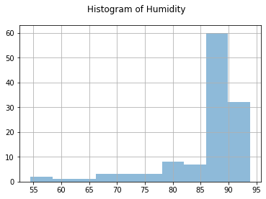
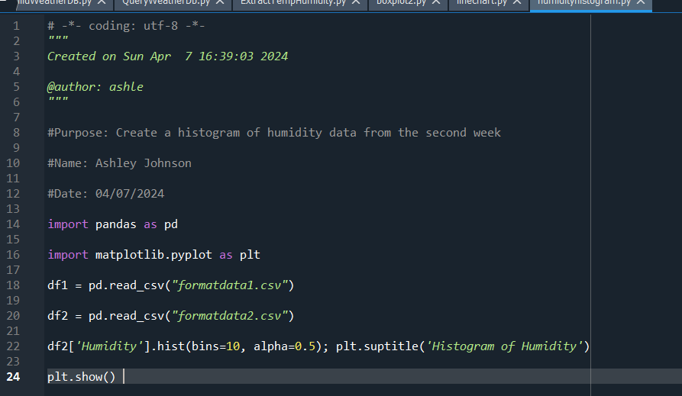
Plot #3
Plot and code used to generate it
Box
Line
Histogram
Scatter

Slide 24
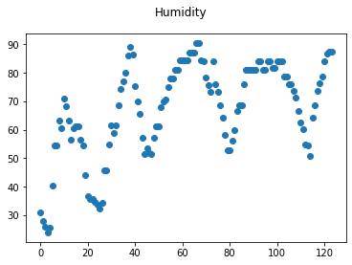
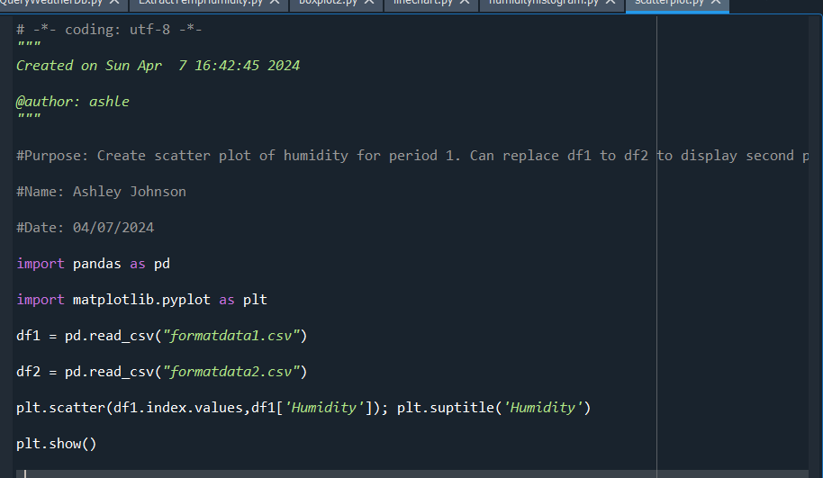
Plot #4
Plot and code used to generate it
Box
Line
Histogram
Scatter

Slide 25
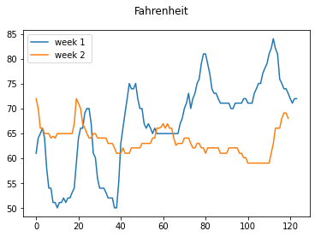
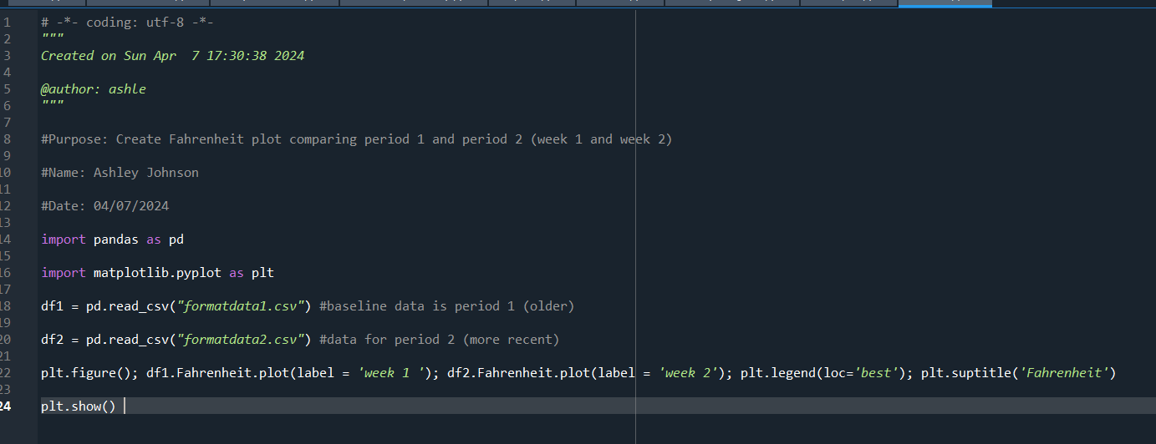
Analysis
Think of your own question and create a chart/graph to answer it
What were the temperatures in Fahrenheit for Week 1 and Week 2?
Answer supported by Chart:

Slide 26
Prediction
Develop a prediction based on the data. Based on the current data, the temperatures for week one were consistent, while week two exhibited significant variation, ranging from the low 50s to the upper 80s. Given this variability, I would predict that the incoming week would be an average of the two. I'd recommend that additional trials be conducted to gather more data points and further understand the fluctuations in temperature. Other factors may also be needed.
What variations in temperature and humidity do you expect over the next few hours or days? Changes in temperature will depend upon weather conditions such as rain/storms. I think the average temps will vary between the 60s and 70s similar to Week 1 and Week 2.
How would humidity change if temperature goes up or down? As temperature increases, the air can hold more moisture, so the relative humidity decreases. As temperature decreases, the air can hold less moisture, so the relative humidity increases.

Slide 27
Challenges
Data quality and consistency: One of the main challenges in this project was ensuring the accuracy and consistency of the weather data collected from various sources. Inaccurate or incomplete data may lead to unreliable predictions and analysis.
Variability in weather patterns: Weather patterns can be highly variable and unpredictable, making it challenging to accurately forecast future weather conditions. Sudden changes in temperature, precipitation, or wind patterns can impact the reliability of predictions.
Limited historical data: The availability of limited historical weather data may restrict the ability to perform long-term trend analysis or generate accurate forecasts. More extensive datasets are often required to improve the accuracy of predictions.
Addressing these challenges through thorough data validation, advanced analytics techniques, and continuous monitoring and adjustment of predictive models can help enhance the accuracy and reliability of weather predictions in the project.

Slide 28
Career Skills
Data analysis and interpretation: Analyzing weather data, identifying trends, and making predictions require strong data analysis skills. This project can help develop skills in data interpretation, statistical analysis, and drawing meaningful insights from complex datasets.
Critical thinking and problem-solving: Addressing challenges such as data variability, limited historical data, and complex weather patterns can enhance critical thinking and problem-solving skills. Finding creative solutions to overcome obstacles in the project can help develop these skills.
Research skills: Gathering weather data from various sources, understanding weather patterns, and exploring different factors that influence weather conditions can improve research skills. Conducting thorough research to validate predictions and analyze trends is essential in this project.
Communication skills: Presenting forecasted temperature trends, explaining data analysis methods, and discussing findings with stakeholders require effective communication skills. This project can help develop skills in conveying complex information in a clear and concise manner.
Technical skills: Working with weather data often involves using specialized software, tools, and programming languages for data analysis and modeling. Developing technical skills in data manipulation, visualization, and modeling can be valuable in this project.
Project management skills: Managing timelines, coordinating data collection, and ensuring the project progresses smoothly require strong project management skills. This project can provide opportunities to enhance skills in organization, planning, and execution.
Adaptability and resilience: Dealing with unpredictable weather patterns, unexpected challenges, and changing project requirements can help develop adaptability and resilience. Learning to adjust strategies, pivot when needed, and persevere in the face of obstacles are important skills acquired during this project.

Slide 29
Conclusion
In conclusion, this project offers valuable hands-on training in programming with data by utilizing weather data gathered from a cloud service to perform data analytics operations. Through this project, I have been able to enhance my skills in data analysis, interpretation, and visualization. By working with real-world weather data, I was able to apply programming techniques to manipulate and analyze data, develop predictive models, and generate insights to inform decision-making.
Engaging in this project provides a practical learning experience that bridges theoretical knowledge with practical application, allowing me to gain proficiency in data analytics and programming in a weather-related context. By leveraging cloud-based services to access and analyze weather data, I can enhance my technical skills, adapt to new technologies, and explore innovative solutions.
Overall, this project served as a valuable opportunity to acquire hands-on experience in programming with data, deepen my understanding of data analytics operations, and develop practical skills that are applicable across various industries. The combination of hands-on training, programming with data, and cloud-based data analytics in a weather context offers a rich learning experience that benefits my career development and future endeavors in data science, analytics, and engineering technology.

