Slide 1
Final project
Ashley Johnson – CEIS 106 Intro to Operating Systems

Slide 2
COURSE PROJECT BACKGROUND
CITED FROM THE COURSE PROJECT OUTLINE DELIVERABLE
"
This project covers the fundamentals of the Linux operating system in a virtualized environment. It includes activities such as navigating the Linux file system, writing shell scripts, managing users and groups, understanding IP configurations, and monitoring system performance.
It lays the foundation for understanding of emerging technologies such as Virtualization and Cloud Computing.
"

Slide 3
Linus filesystem hIERARchy
The "pwd" command in Linux stands for "print working directory." It is used to display the current working directory.
The "cd" command stands for "change directory." It is used to navigate and switch between directories in the file system.
The difference between a relative path and an absolute path in Linux:
Absolute path means that the system has all the information it needs to find the destination because the pathname starts from the root (/) of the system.
A relative pathname is the pathname of a target file or directory relative to your current directory in the tree. It can be used in place of an absolute pathname to reduce typing.

Slide 4
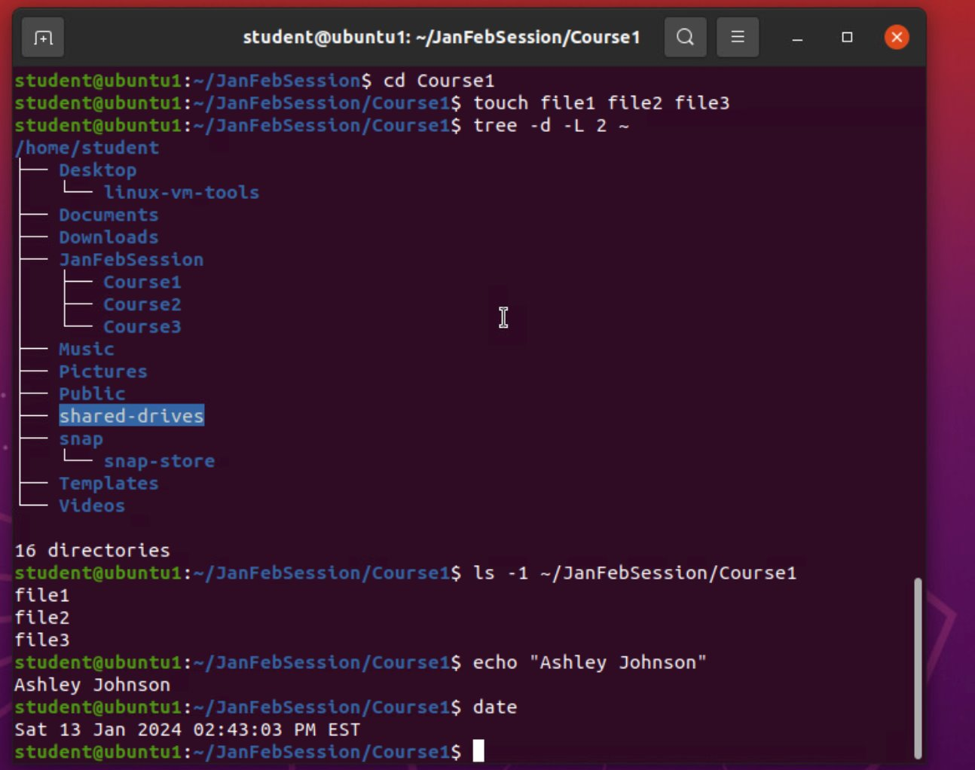
Creating directories and files | create a subdirectory

Slide 5
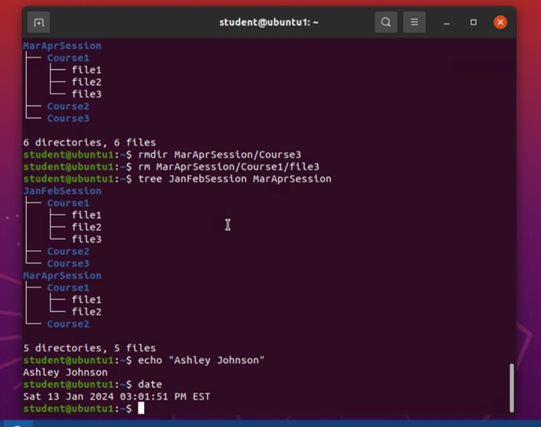
Copy and remove directories and files

Slide 6
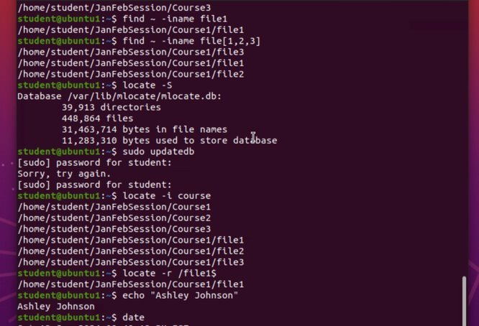
Locate directories and files

Slide 7
Create a shell script
File permissions of the script: rw- rw- r--
The name of the user-defined variable: text
Redirection meta-character sends output of the command to the file and appends to the end of the file.

Slide 8
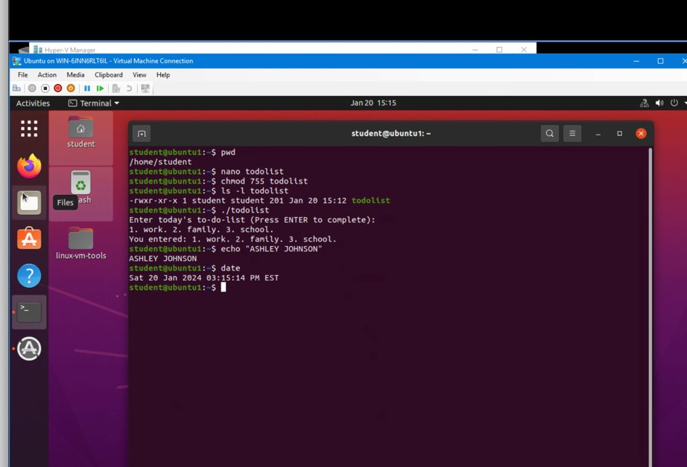
Change script file permissions

Slide 9
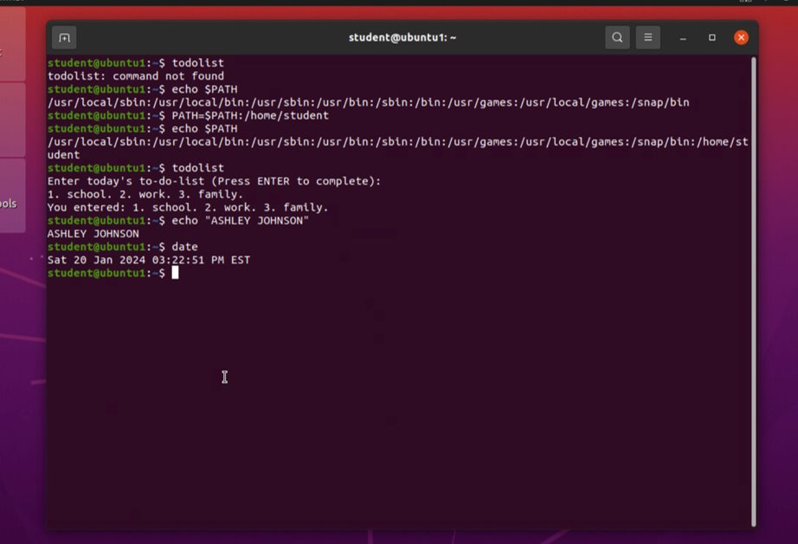
set the path variable

Slide 10
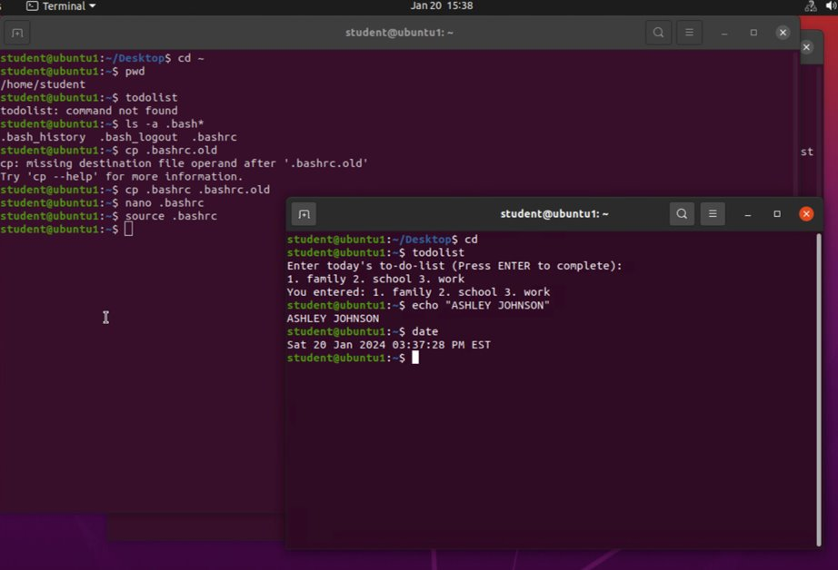
make the path variable permanent

Slide 11
User and group management
The –m option in the useradd command tells it to create a home directory for the new user.
The –3 option in the tail command tells how many lines to show from the end of the file.
The line students:x:1002:mary lists members of the "students" group.

Slide 12
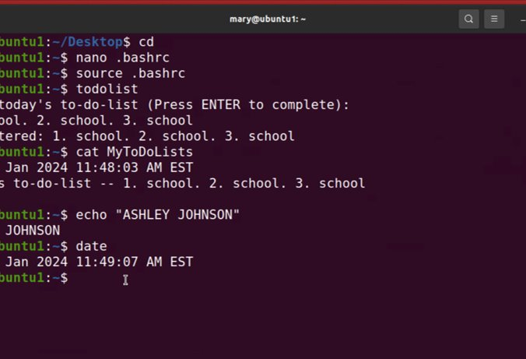
Test user and group settings

Slide 13
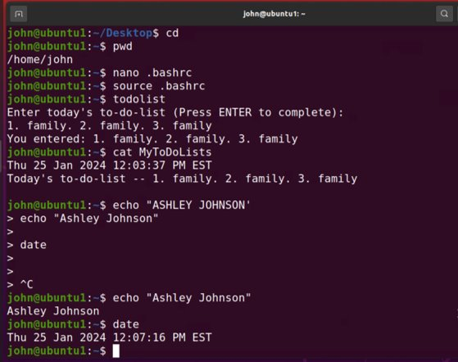
add users in gui

Slide 14
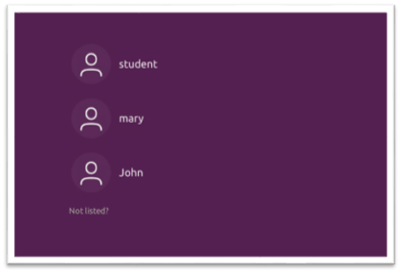
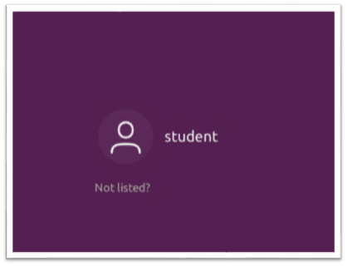
Remove users and groups
Log on page with 3 user accounts.
Log on page with 1 user account.

Slide 15
Operating systems
Discovering host IP configurations
Manage network interfaces
Use network utilities

Slide 16
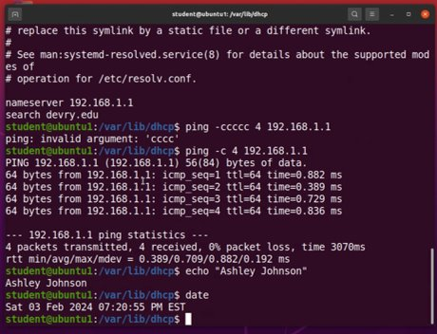
Discover host ip configurations
IP address of my Ubuntu machine
192.168.1.107
IP address of its default gateway
192.168.1.1
IP address of its DHCP server
192.168.1.1
IP address of its DNS server
192.168.1.1

Slide 17
Manage network interfaces
DHCP message shown in the output of the sudo dhclient –v –r ens33 command
DHCPRELEASE
DHCP messages shown in the output of the sudo dhclient –v ens33 command
DHCPDISCOVER
DHCPOFFER
DHCPREQUEST
DHCPACK

Slide 18
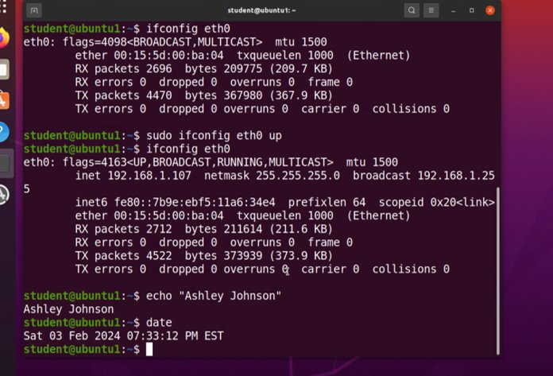
Use network utilities

Slide 19
System performance monitoring
Monitor processes
Monitor user activities
Monitor network bandwidth usage

Slide 20
Monitor linux processes
The default action of the 15 SIGTERM kill signal:
Kill the highlighted process.
In the System Monitor window, click on % CPU to sort the processes by CPU load. The process that shows the highest percentage of CPU usage:
The gnome shell (GUI)

Slide 21
Monitor user activities
Issue the sudo accton on command to turn on GNC accounting. Run the sudo updatedb command. Enter lastcomm updatedb to check if the updatedb command was executed before. Remember to turn off GNC accounting (sudo accton off).
The flag value displayed in the output:
S - "super user"
The name of the user who ran the processes shown as root, is not student because
superuser – since we typed sudo in front of the command.

Slide 22
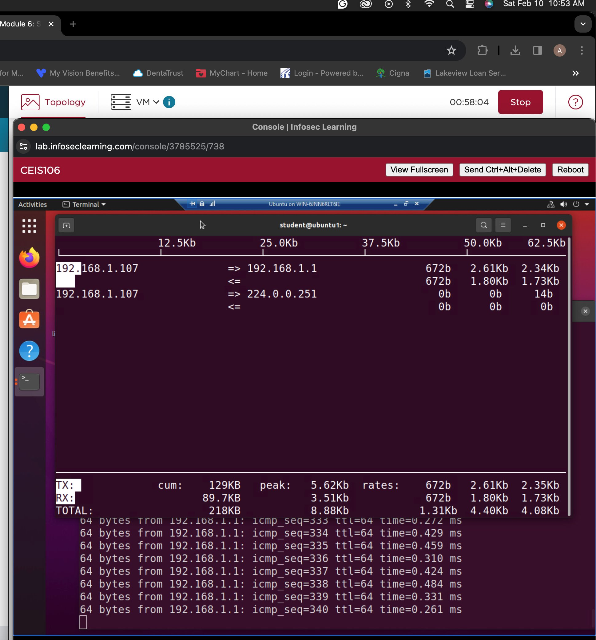
Monitor network bandwidth usage

Slide 23
references
My reference used for making the slides were the course project videos.

Slide 24
Thank you.

