Slide 1

Fundamentals of Information System Security
Final Course Project By: Ashley Johnson

Slide 2

Introduction
The motivation behind this final project is rooted in the comprehensive curriculum that has been covered throughout the semester.
This course has provided an in-depth exploration of the fundamental concepts of information security, including the nature of security attacks and the defense mechanisms designed to thwart them. By delving into the security issues related to data networks and devices, I've gained valuable insights into designing robust security solutions and policies.
The project aims to synthesize the lessons learned and the practical projects completed, thereby solidifying our understanding of key security principles such as confidentiality, integrity, and availability.
Furthermore, the project will encompass a range of critical topics, including file encryption and decryption, the implementation of stateful firewalls, conducting Nmap scans, developing a Bring Your Own Device (BYOD) security policy, configuring multifactor authentication, and performing a comprehensive vulnerability assessment using tools like Nmap, Netcat, Wireshark, and Nessus.
This holistic approach ensures that I not only grasped theoretical concepts but have acquired hands-on experience in deploying effective security measures.

Slide 3
File encryption / decryption

Slide 4
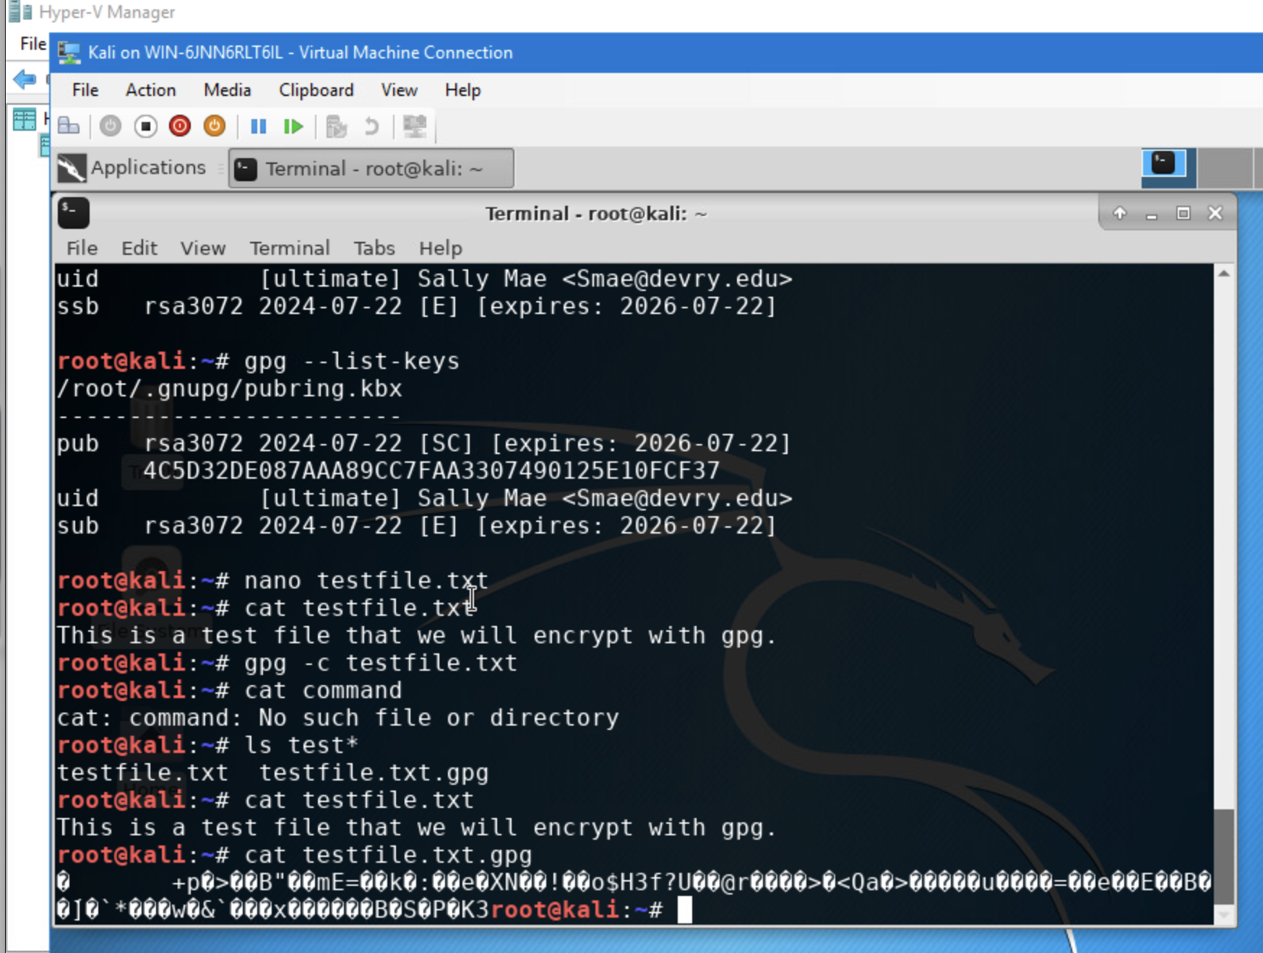
File Encryption
This screenshot should show the following.
Content of the plaintext file
Content of the encrypted file

Slide 5
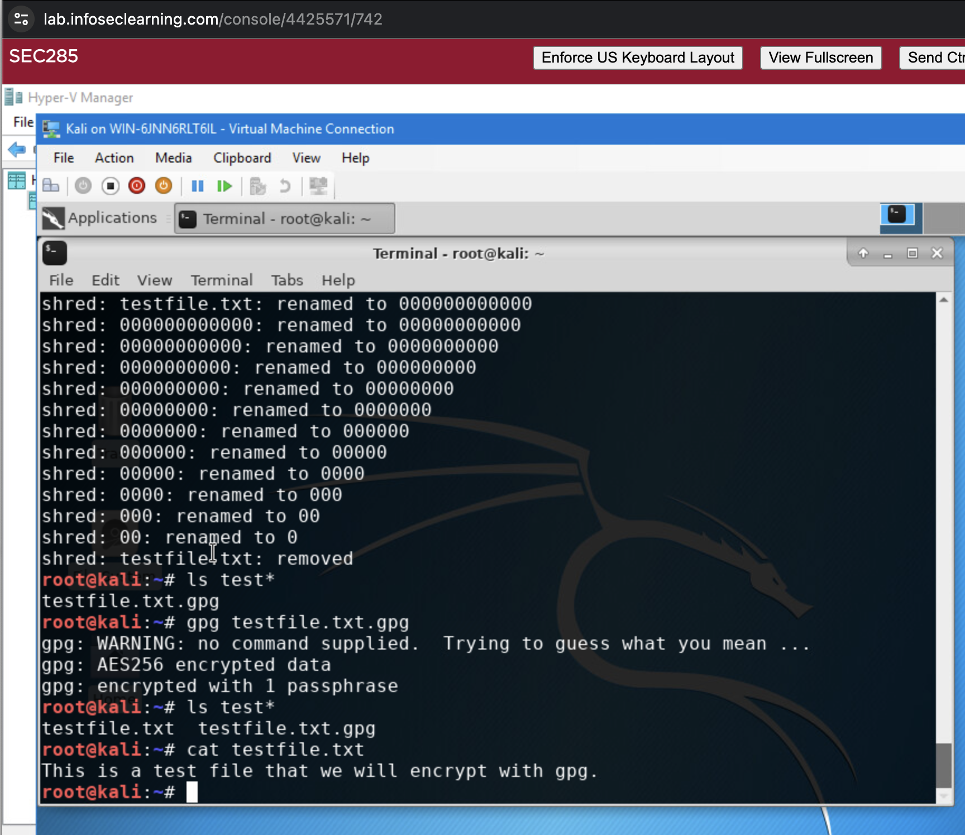
File Decryption
This screenshot should show the following.
The encrypted file being listed by itself
The decrypting process
Both the encrypted file and the original plaintext file being listed

Slide 6
Nmap scan
Input Drop Command

Slide 7
Question
What effect does the sudo iptables --policy INPUT DROP command have on the access to computing resources?
Answer here:
Sets the default policy for incoming traffic (INPUT chain) to DROP, which means that all incoming packets that do not match any specific rule will be dropped or blocked. This command effectively denies all incoming connections unless there are explicit rules allowing certain traffic. As a result, this command can significantly restrict access to computing resources by blocking incoming connections, enhancing network security by only allowing traffic that is explicitly permitted through firewall rules.
References:
https://www.comparitech.com/net-admin/beginners-guide-ip-tables/

Slide 8
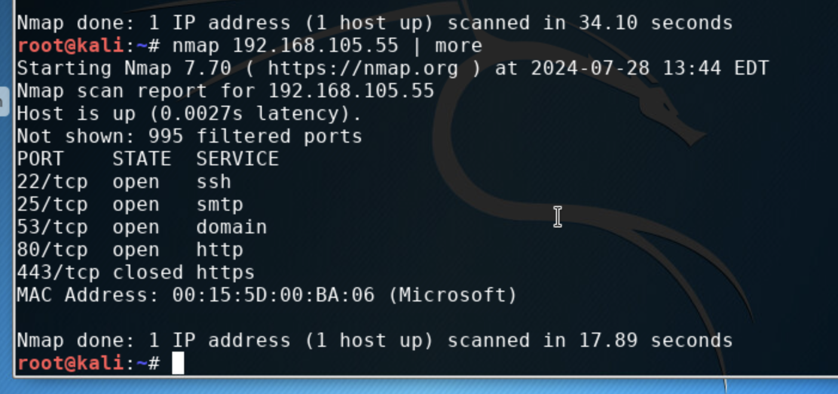
Nmap Scan
This screenshot should show the Nmap scan result of the Linux Server VM.

Slide 9
Bring your own device (byod)
Security Policy Creation

Slide 10
Overview:
In today's modern enterprises, the use of personal devices, such as tablets, smartphones, and laptops, has become increasingly prevalent. The phenomenon of Bring Your Own Device (BYOD) has gained significant traction, as it offers employees the convenience of using their familiar devices for work-related tasks, thereby improving productivity and work-life balance.
However, the widespread adoption of BYOD practices also introduces a range of security risks that organizations must address. These devices, often outside the direct control of the IT department, can potentially expose sensitive corporate data to unauthorized access, data breaches, and other cyber threats.
Some of the key threats associated with BYOD devices include:
1. Data Leakage: Personal devices may not have the same level of security measures as corporate-owned devices, increasing the risk of data leakage or unauthorized access to sensitive information.
2. Malware Infections: BYOD devices can be vulnerable to malware, such as viruses, spyware, and ransomware, which can compromise the security of the corporate network and the data accessed through these devices.
3. Loss or Theft: The portability of BYOD devices increases the risk of loss or theft, which can lead to the exposure of sensitive corporate data if the device is not properly secured.
4. Unsecured Connections: Employees may use their BYOD devices to connect to unsecured public Wi-Fi networks, exposing corporate data to potential eavesdropping or man-in-the-middle attacks.
5. Lack of Visibility and Control: IT departments may have limited visibility and control over BYOD devices, making it challenging to enforce security policies and monitor for potential threats.
6. Compliance Concerns: BYOD practices may introduce compliance challenges, particularly in industries with strict data privacy and security regulations, such as healthcare, finance, and government.
To address these security risks and ensure the effective implementation of a BYOD program, ABC Corporation must develop a comprehensive BYOD security policy that provides clear guidelines and measures to mitigate the identified threats.

Slide 11
2. Purpose:
The primary goal of ABC Corporation's BYOD security policy is to protect the confidentiality, integrity, and availability (CIA) of the organization's data and computing resources. By implementing a comprehensive BYOD security policy, ABC Corporation aims to identify and mitigate the vulnerabilities introduced by employees' personal devices, thereby reducing the attack vector on the organization's computing resources.
The timely discovery of vulnerabilities associated with BYOD devices is crucial in reducing the risk of successful cyber-attacks. When vulnerabilities are identified and addressed promptly, the organization can take proactive measures to secure its computing resources and minimize the potential impact of such threats.
Some key reasons why the BYOD security policy is necessary to identify and address vulnerabilities in a timely manner:
1. Reduced Attack Surface: By identifying and addressing vulnerabilities in BYOD devices, ABC Corporation can effectively reduce the overall attack surface of its computing infrastructure. This, in turn, makes it more challenging for malicious actors to gain unauthorized access to the organization's sensitive data and systems.
2. Improved Incident Response: Timely detection and remediation of vulnerabilities in BYOD devices allows ABC Corporation to respond more effectively to security incidents. The organization can quickly isolate compromised devices, contain the spread of threats, and minimize the damage caused by potential data breaches or system disruptions.
3. Compliance and Regulatory Requirements: Many industries, such as healthcare, finance, and government, have strict data privacy and security regulations that must be adhered to. ABC Corporation's BYOD security policy will help the organization maintain compliance by ensuring that personal devices used for work purposes meet the necessary security standards and controls.
4. Reputation and Customer Trust: A strong BYOD security policy demonstrates ABC Corporation's commitment to protecting its data and computing resources, which can enhance the organization's reputation and maintain customer trust. This is particularly important in today's digital landscape, where data breaches and cyber-attacks can have significant reputational and financial consequences.
By implementing a comprehensive BYOD security policy that focuses on the timely discovery and mitigation of vulnerabilities, ABC Corporation can effectively reduce the attack vector on its computing resources, protect the CIA of its data, and maintain compliance with relevant regulations and industry standards.

Slide 12
3. Scope:
The BYOD security policy at ABC Corporation will apply to all employees who wish to use their personal devices, including smartphones, tablets, and laptops, to access the organization's computing resources and data. The policy will encompass the following:
1. Approved Devices:
-ABC Corporation will allow the use of personal smartphones, tablets, and laptops, provided they meet the minimum-security requirements outlined in the policy.
-Employees must obtain formal approval from the IT department before connecting their personal devices to the corporate network.
2. Allowed Activities:
- Employees are permitted to use their approved personal devices to access corporate email, calendars, contacts, and approved business applications.
- Accessing and storing sensitive or confidential company data on personal devices is strictly prohibited, unless explicitly authorized by the IT department.
- Employees are not allowed to use their personal devices for activities that may compromise the security or integrity of the corporate network, such as downloading unauthorized software, accessing inappropriate content, or engaging in illegal activities.
3. Device Management and Responsibilities:
- The IT department is responsible for reviewing and approving the use of personal devices on the corporate network.
- Employees must register their personal devices with the IT department and agree to the terms and conditions outlined in the BYOD security policy.
- Employees are responsible for ensuring that their personal devices are kept up-to-date with the latest security patches and antivirus software.
The IT department reserves the right to remotely wipe or disable any personal device suspected of being compromised or used in a way that violates the BYOD security policy.
Compliance and Enforcement:
- Failure to comply with the BYOD security policy may result in disciplinary action, including the revocation of the employee's access to corporate resources and potential termination of employment.
- The BYOD security policy will be reviewed and updated periodically to address changes in technology, security threats, and regulatory requirements.
By clearly defining the scope of the BYOD security policy, ABC Corporation can effectively manage the use of personal devices on the corporate network, mitigate security risks, and ensure the protection of its computing resources and data.

Slide 13
4. Policy:
ABC Corporation's BYOD security policy requires that all personal devices be subject to a comprehensive security assessment before being granted access to the corporate network. This assessment ensures that the devices meet the minimum-security requirements necessary to protect the organization's computing resources and data.
To be considered compliant and gain access to the ABC Corporation network, personal devices must meet the following criteria:
1. Operating System:
- Devices must be running the latest version of the operating system (OS) with all available security patches and updates installed.
- Supported OS platforms include Windows 10 (or later), macOS 10.15 (or later), and the latest versions of iOS and Android.
2. Antivirus and Malware Protection:
- Devices must have reputable antivirus/anti-malware software installed and configured to provide real-time protection.
- The antivirus/anti-malware software must be kept up to date with the latest virus definitions and security updates.
3. Firewall:
- Devices must have a functional firewall enabled, either the built-in firewall provided by the OS or a third-party firewall solution.
- The firewall must be properly configured to monitor and control incoming and outgoing network traffic.
4. Encryption:
- Devices must have full-disk encryption or file-level encryption enabled to protect sensitive data stored on the device.
- Encryption must be implemented using industry-standard algorithms and protocols, such as AES-256 or BitLocker.
5. Remote Wipe and Lock:
- Devices must have remote wipe and lock capabilities enabled, allowing the IT department to remotely secure the device in the event of loss or theft.
If a personal device does not meet the minimum-security requirements, the employee will be required to remediate the identified issues before the device can be granted access to the ABC Corporation network. The employee is responsible for ensuring that the necessary security measures are implemented on their personal devices.
The IT department will provide guidance and support to employees on the remediation process, but the employee is ultimately accountable for ensuring that their device is compliant with the BYOD security policy. Failure to comply with the policy may result in the denial of network access or disciplinary action, as outlined in the policy.

Slide 14
5. Policy Compliance:
ABC Corporation's IT department will be responsible for verifying and enforcing compliance with the BYOD security policy through various methods, including but not limited to:
1. Periodic Device Assessments:
- The IT department will conduct regular, unannounced assessments of personal devices connected to the corporate network to ensure they continue to meet the minimum security requirements.
- These assessments may include on-site inspections, remote device scans, and review of device configuration and security settings.
2. Monitoring and Logging:
- ABC Corporation will utilize intrusion detection and prevention systems, as well as network monitoring tools, to continuously monitor the activities of BYOD devices on the corporate network.
- Logs and reports generated from these tools will be regularly reviewed to identify any suspicious or non-compliant behavior.
3. Internal and External Audits:
- The BYOD security policy and its implementation will be subject to regular internal audits by the IT department and the corporate security team.
- Additionally, ABC Corporation may engage external security auditors to conduct periodic assessments of the BYOD program and its compliance with industry standards and regulatory requirements.
4. Employee Feedback:
- Employees are encouraged to report any suspected security incidents or policy violations related to BYOD devices to the IT department or the corporate security team.
- The IT department will investigate all reported incidents and take appropriate actions to address any identified issues.
Employees found to be in violation of the BYOD security policy may be subject to disciplinary actions, up to and including termination of employment. Depending on the severity of the violation, the following consequences may apply:
- First Offense: The employee will receive a formal warning and be required to remediate the identified security issues within a specified timeframe.
- Repeated Offenses: The employee's BYOD privileges may be revoked, and they may be restricted to using only company-issued devices for work-related activities.
- Egregious Violations: In cases of serious security breaches or intentional disregard for the BYOD security policy, the employee may face immediate termination of employment.
The IT department, in collaboration with the human resources and legal teams, will be responsible for determining the appropriate disciplinary actions based on the nature and severity of the policy violation.

Slide 15
6. Related Standards, Policies, and Processes:
ABC Corporation's BYOD security policy is closely aligned with and supported by several other organizational policies, standards, and regulatory requirements. These include, but are not limited to:
1. Information Security Policy:
- The BYOD security policy is a subset of the organization's overall Information Security Policy, which outlines the overarching principles and controls for protecting the confidentiality, integrity, and availability of ABC Corporation's data and computing resources.
- Alignment with the Information Security Policy ensures that the BYOD security measures are consistent with the organization's broader security strategy and objectives
2. Acceptable Use Policy:
- The BYOD security policy should be read in conjunction with ABC Corporation's Acceptable Use Policy, which defines the appropriate and authorized use of the organization's computing resources, including personal devices.
- Employees must comply with the Acceptable Use Policy when accessing corporate data and systems using their personal devices.
3. Data Classification and Handling Policy:
- The BYOD security policy is closely linked to ABC Corporation's Data Classification and Handling Policy, which categorizes data based on its sensitivity and criticality, and outlines the appropriate security controls for each data classification level.
- This policy helps to ensure that sensitive or confidential data is not stored or accessed on personal devices without the necessary safeguards.
4. HIPAA (Health Insurance Portability and Accountability Act) Compliance:
- If ABC Corporation operates in the healthcare industry and handles protected health information (PHI), the BYOD security policy must align with the HIPAA Security Rule, which sets standards for the protection of electronic PHI (ePHI).
- Compliance with HIPAA requirements is crucial to maintain the confidentiality and integrity of sensitive patient data.
5. PCI-DSS (Payment Card Industry Data Security Standard):
- If ABC Corporation processes or stores payment card information, the BYOD security policy must be compatible with the PCI-DSS requirements, which establish security controls for the protection of cardholder data.
- Adherence to PCI-DSS standards is essential to prevent data breaches and financial fraud.
By aligning the BYOD security policy with these related standards, policies, and regulatory requirements, ABC Corporation can ensure a comprehensive and consistent approach to information security across all departments.

Slide 16
7. Definitions and Terms:
The following definitions and terms are relevant to the BYOD (Bring Your Own Device) security policy at ABC Corporation:
1. BYOD (Bring Your Own Device): BYOD refers to the practice of employees using their personal mobile devices, such as smartphones, tablets, or laptops, to access corporate computing resources, data, and applications.
2. Mobile Devices: Mobile devices include any portable, handheld, or laptop-style computing devices that can be used to access the corporate network and data, including but not limited to smartphones, tablets, and personal laptops.
3. CIA Triad: The CIA Triad is a model that represents the three primary goals of information security: Confidentiality, Integrity, and Availability.
- Confidentiality: Ensuring that information is accessible only to authorized individuals or entities.
- Integrity: Maintaining the accuracy and completeness of information and preventing unauthorized modification or tampering.
- Availability: Ensuring that authorized users have reliable and timely access to information and resources when needed.
4. Compliance: Compliance refers to the state of adhering to the requirements and guidelines outlined in the BYOD security policy, as well as any relevant industry standards, regulations, or legal requirements.
5. Remediation: Remediation is the process of addressing and resolving any identified security issues or non-compliance with the BYOD security policy on a personal device.
6. Remote Wipe: Remote wipe is the ability to remotely erase or delete all data stored on a personal device, typically in the event of loss, theft, or suspected security breach.
7. Encryption: Encryption is the process of converting information or data into a coded format that can only be accessed or read by authorized individuals or entities with the correct decryption key or algorithm.
These definitions and terms provide a common understanding of the key concepts and components related to the BYOD security policy at ABC Corporation, ensuring that all employees and stakeholders have a clear and consistent understanding of the policy's scope and requirements.
8. Revision History:
Date of change | Responsible | Summary of change
August 2019 | SANS policy team | Updated and converted to new format
August 2024 | Ashley Johnson | Updated Sections 1-8.

Slide 17
Multifactor authentication (mfa)
Common-Auth Configuration File
MFA Logon Screen

Slide 18
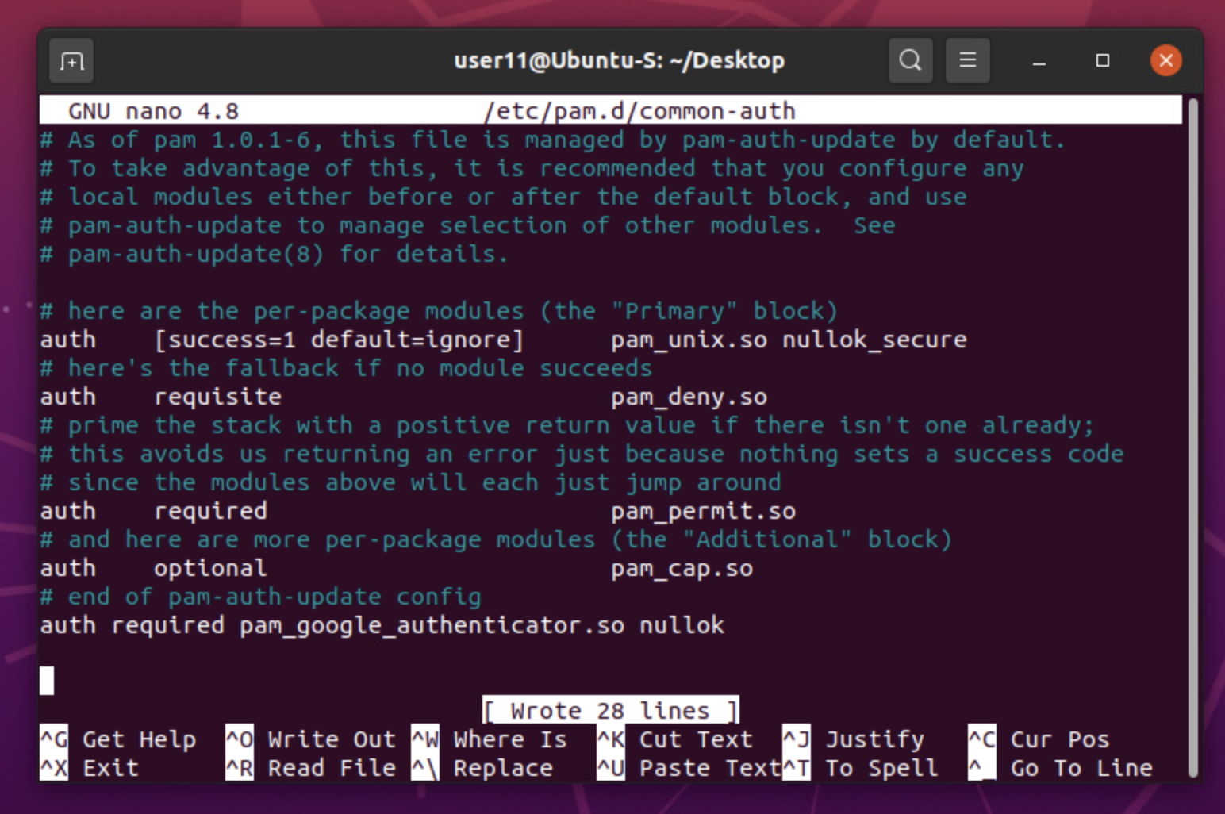
Common-auth Configuration File
This screenshot should show the entry that indicates the use of the Google Authenticator module.

Slide 19
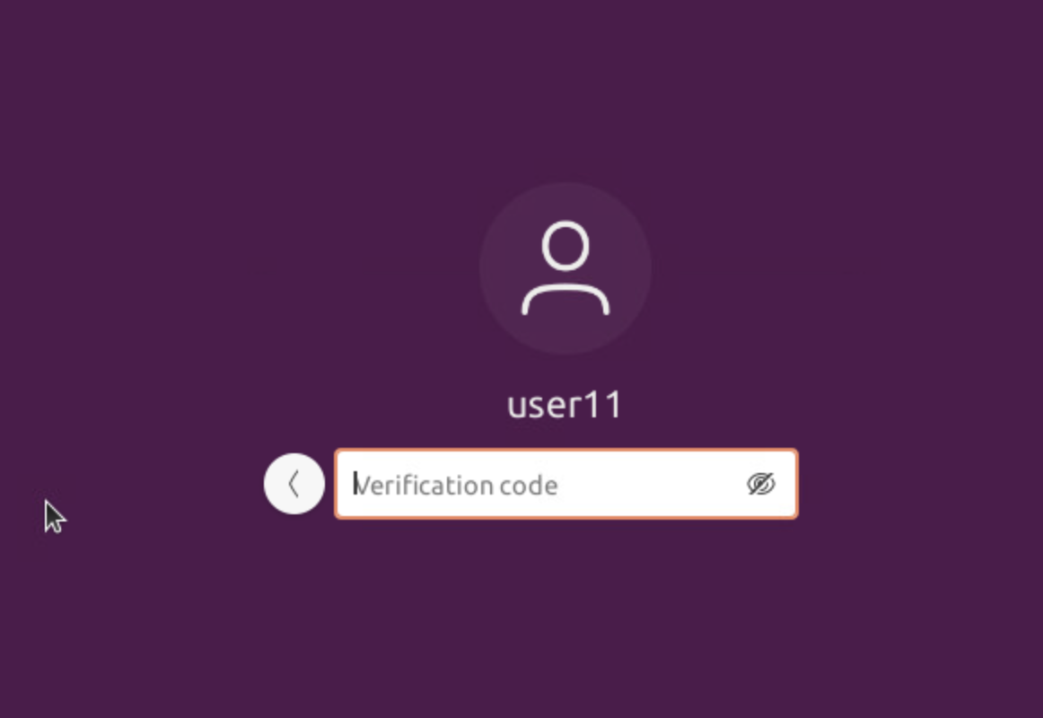
MFA Logon Screen
This screenshot should show the logon screen where a verification code is required.

Slide 20
Vulnerability assessment
Nmap - NetCat - Wireshark - Nessus

Slide 21
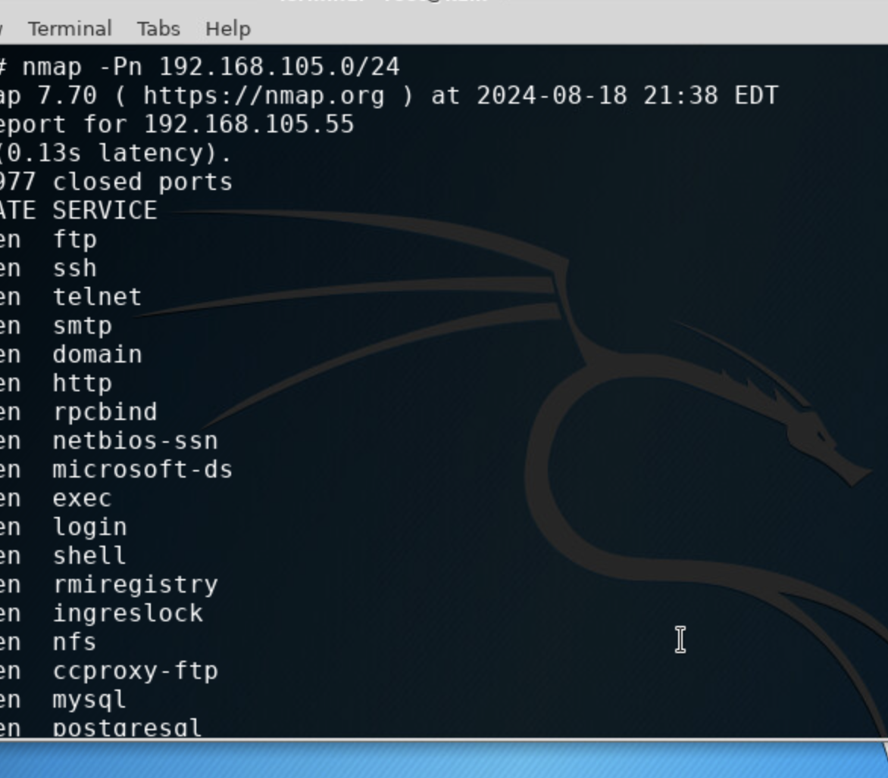
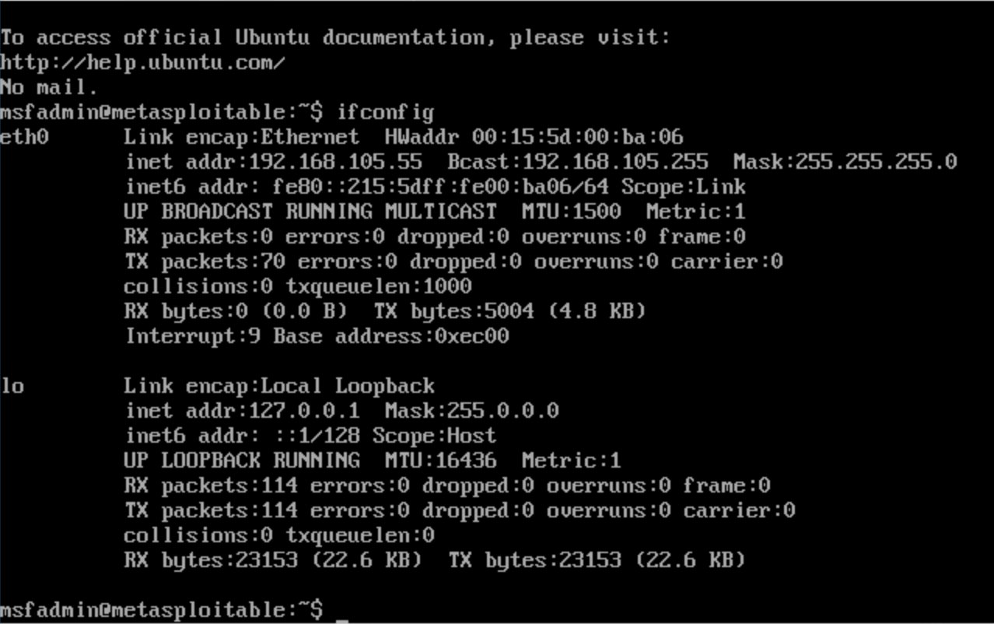
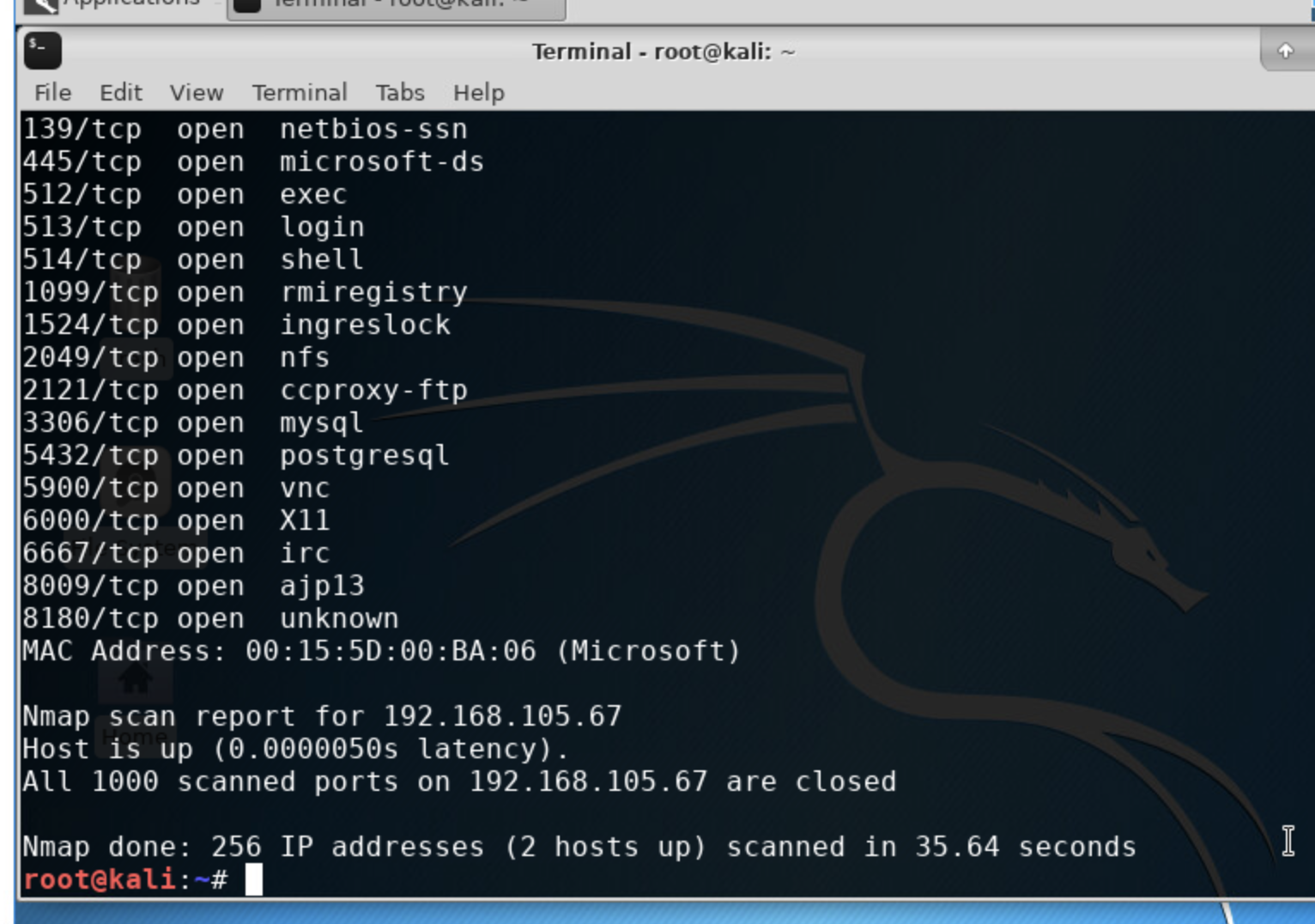
Nmap
This screenshot should include the scan result showing both the Kali and Linux Server VMs.

Slide 22
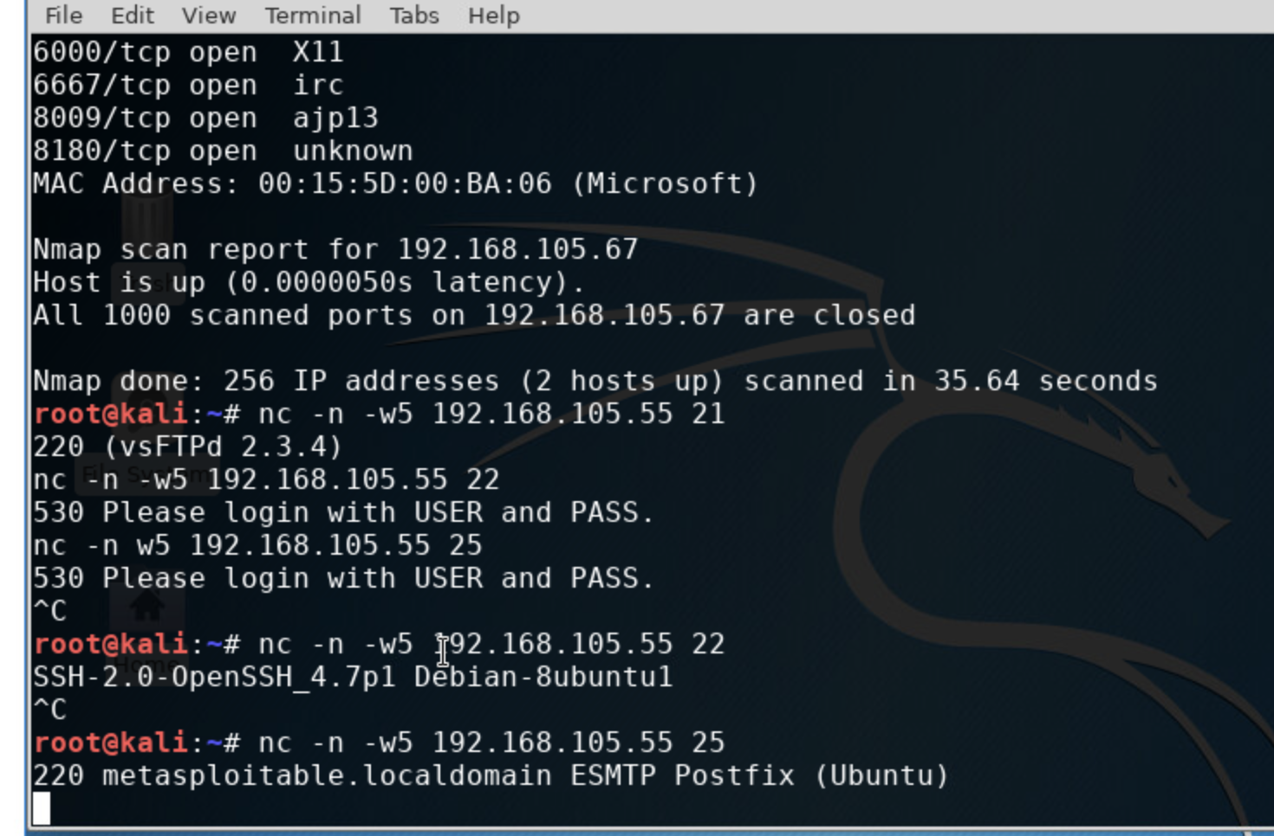
NetCat
This screenshot should include the scan result showing both the Kali and Linux Server VMs.

Slide 23
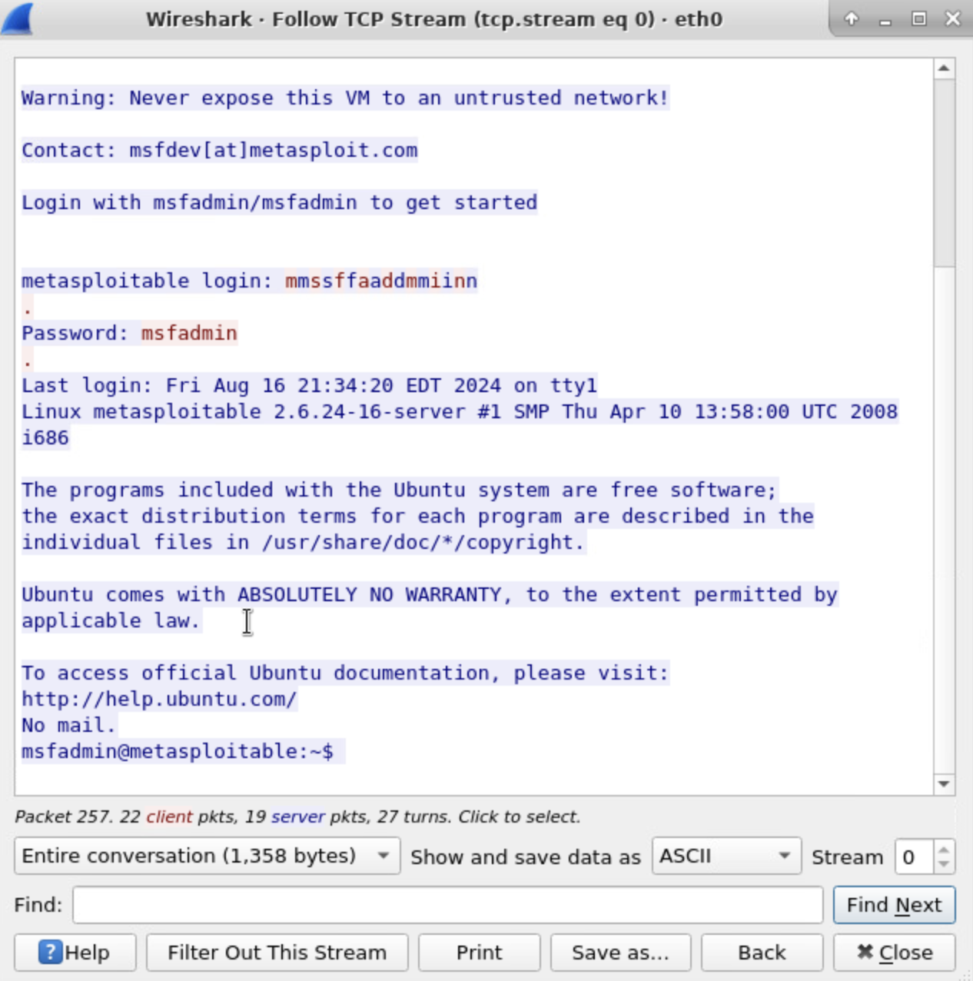
Wireshark
This screenshot should include the Wireshark—Follow TCP Steam window showing the Telnet username and password.

Slide 24
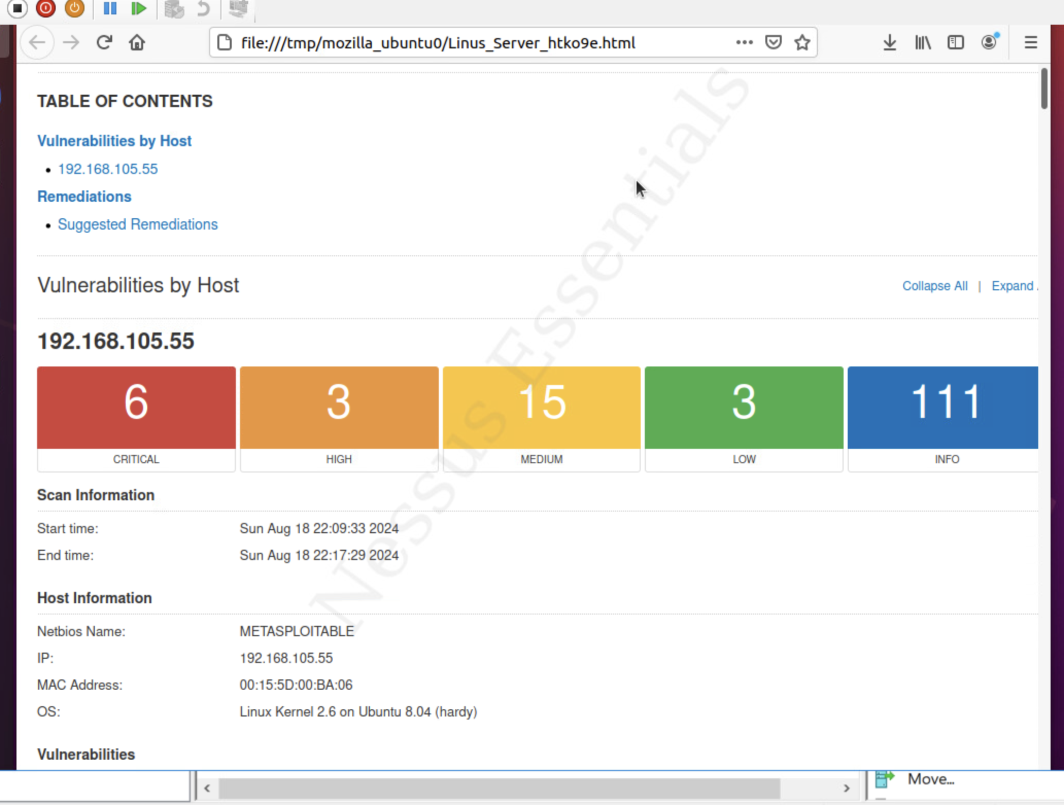
Nessus
This screenshot should include the high-level view of the Nessus vulnerability scan report (showing categories of vulnerability in different colors).

Slide 25
Challenges
Undertaking the final project for the Fundamentals of Information System Security course presents a multitude of challenges that one may encounter. Firstly, the integration of various topics such as file encryption and decryption, stateful firewalls, and multifactor authentication (MFA) necessitates a strong grasp of diverse technical skills and concepts. Balancing these different aspects can be daunting, especially for those who may have a stronger inclination towards certain areas over others.
Secondly, the practical implementation of tools like Nmap, Netcat, Wireshark, and Nessus for vulnerability assessments poses its own set of difficulties. Each tool has its own learning curve, and effectively utilizing them requires not only understanding their functionalities but also interpreting the results accurately. Misconfigurations or misinterpretations can lead to incomplete or incorrect assessments, thereby undermining the project's objectives.

Slide 26
Challenges, cont.
Moreover, developing a Bring Your Own Device (BYOD) security policy introduces a layer of complexity that goes beyond technical skills. It requires understanding organizational behavior, compliance requirements, and the balance between security and user convenience. Crafting a policy that is both robust and pragmatic can be quite challenging.
Time management also emerges as a significant hurdle. The project demands a considerable amount of time for research, implementation, testing, and documentation. Juggling these tasks alongside other academic and personal responsibilities can be overwhelming.
Lastly, ensuring that the final deliverables adhere to the principles of confidentiality, integrity, and availability requires meticulous attention to detail. Any oversight or lapse in these areas could compromise the overall effectiveness of the project, highlighting the need for a disciplined and thorough approach.
In summary, while the final project is an excellent opportunity to consolidate and apply what has been learned, it presents challenges in technical proficiency, tool implementation, policy development, time management, and adherence to core security principles. Overcoming these challenges will not only enhance one's technical skills but also prepare them for real-world cybersecurity scenarios.

Slide 27
Career skills obtained
1. Technical Proficiency:
- File Encryption and Decryption: Understanding cryptographic principles and implementing encryption algorithms to protect data.
- Stateful Firewall Configuration: Setting up and managing firewalls to monitor and control incoming and outgoing network traffic.
2. Network Security:
- Nmap Scanning: Conducting network scans to identify open ports, services, and potential vulnerabilities.
- Vulnerability Assessment: Utilizing tools like Nmap, Netcat, Wireshark, and Nessus to assess system vulnerabilities and recommend mitigation strategies.
3. Policy Development:
- BYOD Security Policy: Creating comprehensive policies for managing personal devices within an organizational network, balancing security with user accessibility.
4. Authentication and Access Control:
- Multifactor Authentication (MFA): Implementing and configuring MFA to enhance security by requiring multiple forms of verification.
- Common Auth Configuration: Setting up and managing authentication mechanisms and understanding their integration within systems.
5. Analytical Skills:
- Interpreting Security Data: Analyzing data from various security tools to identify threats and vulnerabilities.
- Troubleshooting: Diagnosing and resolving security issues based on analysis and interpretation of security data.

Slide 28
Career skills obtained
6. Project Management:
- Time Management: Balancing multiple tasks and deadlines effectively to complete the project within the given timeframe.
- Documentation: Keeping detailed records of configurations, policies, and findings, which is crucial for both academic evaluation and professional practice.
7. Attention to Detail:
- Ensuring that all aspects of the project adhere to security principles of confidentiality, integrity, and availability, and that there are no oversights in implementation.
8. Problem-Solving Skills:
- Developing innovative solutions to complex security issues and adapting to new challenges as they arise during the project.
9. Communication Skills:
- Articulating technical findings and recommendations clearly and effectively, both in written reports and potentially in presentations.
10. Hands-On Experience:
- Gaining practical experience with industry-standard tools and techniques, which enhances employability and readiness for real-world cybersecurity roles.
These skills collectively prepare students for a wide range of roles in the cybersecurity field, including security analyst

