Slide 1
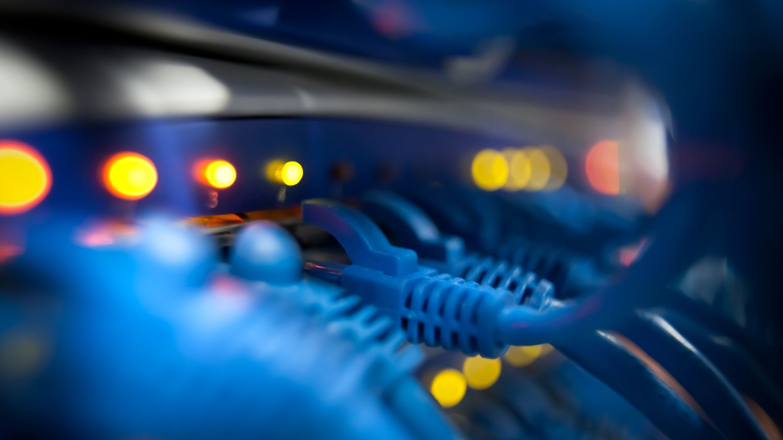
Everything Networking
Ashley Johnson

Slide 2
NETW191 Final Project
Networks
The Internet of Things is growing like crazy, with new technologies and applications popping up all the time. This means there are tons of new job opportunities out there, each requiring specific skills. It's important to keep up with the skills needed for this changing job market and to take advantage of the learning opportunities available.
This final course project covers the networking basics essential for the world of IoT. I've used what I have learned about setting up SOHO routers, subnetting, testing connectivity, documenting networks, and securing wireless networks. These skills will give a solid foundation for learning about new technologies like IoT and prepare me for a career in Information Technology.
At the end of each section, I have included a conclusions page to discuss what I have learned and the skills that were obtained that help when joining the workforce.

Slide 3
NETW191 Course Project Module 2 IPv4 Addressing

Slide 4
Introduction
Understanding methods to address and locate devices on a network, as well as how data travels between hosts at different network layers, will be crucial in engineering design. This knowledge will help in designing efficient and secure network systems, ensuring seamless communication between devices.
Additionally, being familiar with protocols that offer encryption and remote access will be valuable in designing secure and reliable systems. Troubleshooting network issues using command-line utilities will also be a valuable skill in ensuring the smooth operation of network systems in engineering design projects.
Overall, mastering these objectives will enhance my ability to design robust and efficient network systems in my future engineering career.

Slide 5
Preparation
This screenshot should include the terminal window that shows the default gateway IP address.
This screenshot should also show the date/time information on top of the Terminal window.

Slide 6
IPv4 Address Assignment
This screenshot should include the Interfaces page that shows the new IPv4 address on the LAN interface.
This screenshot should also show the date/time information next to the Firefox Web Browser tab.

Slide 7
Conclusions
The topics studied this week included:
Methods used to address and find software, files, computers, and other devices on a network.
How an application’s data and instructions make the trip from one host to another at the transport, network, and data link layers.
Protocols that offer security through encryption or network access over remote connections.
How to troubleshoot common addressing and network problems by using common command-line utilities.
Understanding these methods to address and locate devices on a network, as well as how data travels between hosts at different network layers, will be crucial in engineering design such as:
Designing efficient and secure network systems
Ensuring seamless communication between devices
Familiarizing oneself with encryption and remote access for designing these systems.
Troubleshooting network issues using command-line utilities will also be a valuable skill in ensuring the smooth operation of the network(s). I was able to find the mistake I was previously making, and make the corrections needed for the final result.

Slide 8
NETW191 Course Project Module 3 Connectivity Test

Slide 9
Introduction
Module Overview:
Connectivity Test for SOHO Router:
This module aims to evaluate the connectivity and functionality of a Small Office/Home Office (SOHO) router. It covers various aspects of network connectivity, including:
Major Steps:
1. Data Transmission:
- Understand the principles of data transmission and network protocols
- Identify common problems and solutions related to data transmission
2. Wireless Transmissions:
- Explain how wireless transmissions work and their advantages/disadvantages
- Outline the setup, management, and troubleshooting of wireless networks
3. SOHO Router Connectivity Test:
- Test connectivity between two computers and the SOHO router
- Verify the functionality of the router's switching, routing, and NAT capabilities
- Troubleshoot any connectivity issues that may arise
4. Network Security:
- Discuss basic network security measures for SOHO routers
- Explain how to configure and maintain secure wireless networks

Slide 10
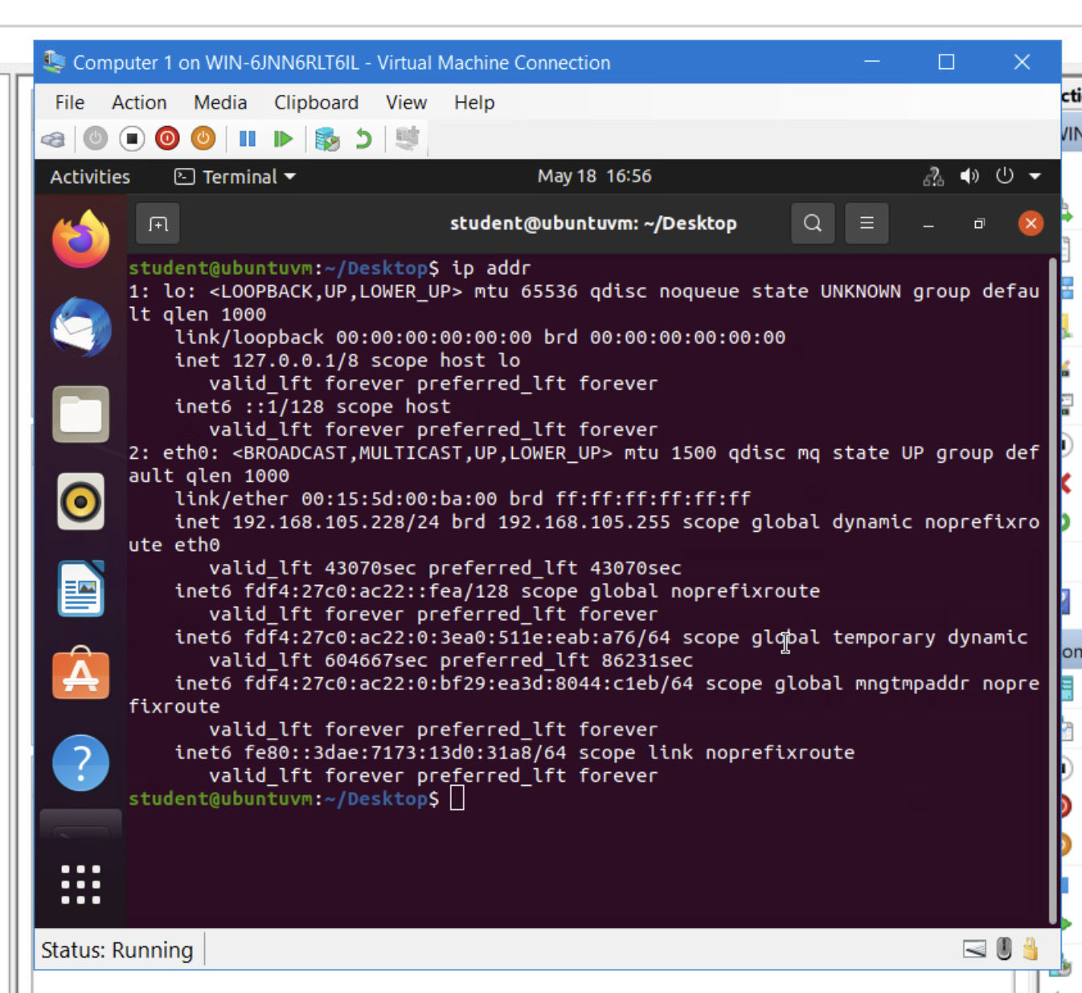
Dynamic IP Address Assignment
Take a screenshot of the Terminal window.
This screenshot should show the IPv4 address of the Computer 1 VM.
This screenshot should also show the date/time information on top of the Terminal window.

Slide 11
Dynamic IP Address Assignment
Take a screenshot of the Terminal window.
This screenshot should show the IPv4 address of the Computer 2 VM.
This screenshot should also show the date/time information on top of the Terminal window.

Slide 12
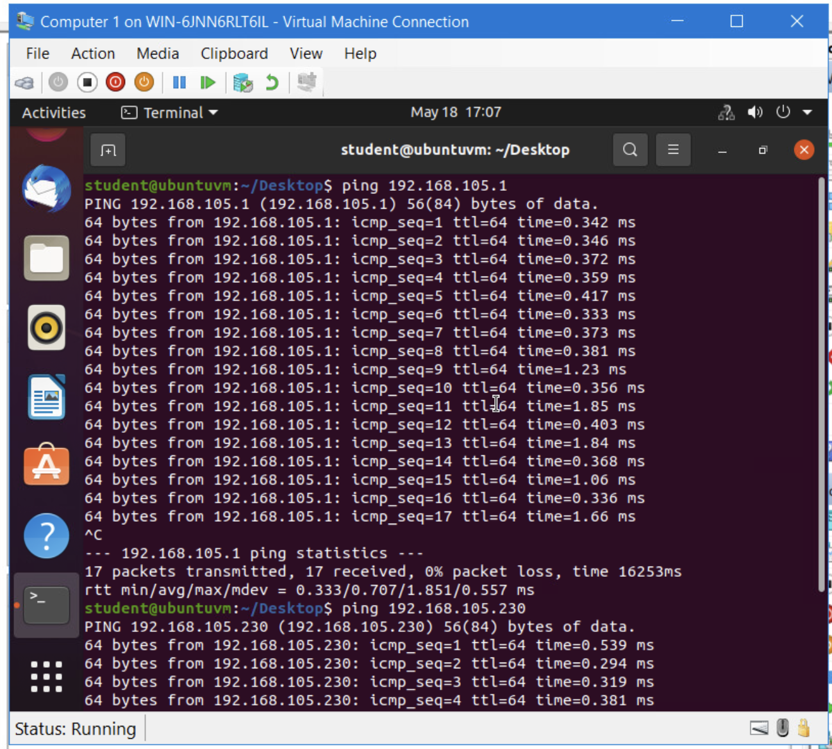
Connectivity Test
Take a screenshot of the Terminal window.
This screenshot should show 1) the connectivity test FROM the Computer 1 VM TO the SOHO Router VM, and 2) the connectivity test FROM the Computer 1 VM TO the Computer 2 VM.
This screenshot should also show the date/time information on top of the Terminal window.

Slide 13
Connectivity Test
Take a screenshot of the Terminal window.
This screenshot should show 1) the connectivity test FROM the Computer 2 VM TO the SOHO Router VM, and 2) the connectivity test FROM the Computer 2 VM TO the Computer 1 VM.
This screenshot should also show the date/time information on top of the Terminal window.

Slide 14
Conclusions
The course project aimed to evaluate the connectivity of a SOHO router, assessing its ability to facilitate data transmission, routing, and wireless access.
The module focused on:
* Understanding data transmission principles
* Identifying and resolving common transmission issues
* Exploring wireless transmission mechanisms
* Establishing, managing, and securing local wireless networks
Conclusions:
The project demonstrated the core functionality of a SOHO router, including:
* Switch support for multiple interfaces
* Routing capabilities connecting devices to the WAN
* Automatic network address translation
* Wireless access point functionality
Technical Challenges Faced
* Troubleshooting connectivity issues between devices and the router
* Optimizing wireless signal strength and stability
* Configuring security measures to protect the network
Career Skills Gained
The project provided hands-on experience in:
* Network connectivity testing
* Data transmission analysis
* Wireless network setup and troubleshooting
* Network security implementation
* Engineering problem-solving and critical thinking
These skills are essential for careers in engineering technology, particularly in the fields of networking, communications, and wireless systems design.

Slide 15
NETW191 Course Project Module 4 IP Subnetting and Loopback Interfaces

Slide 16
Introduction
In this project, I will be working with a class C network to create smaller subnets for two LAN segments. By dividing the block of IP addresses into smaller blocks, I will be able to configure two Loopback interfaces on the SOHO Router. This will allow me to simulate two separate LAN segments within the network. Through this hands-on exercise, I will gain a better understanding of subnetting and network segmentation. This project will provide valuable insight into network configuration and management, as well as practical experience in setting up virtual LANs.

Slide 17
IP Subnetting
Subnet ID | Network Mask (/prefix) | Network Mask (Dotted decimal) | Network Address | First Usable Host Address | Last Usable Host Address | Broadcast Address
0 | /25 | 255.255.255.128 | 192.168.5.0 | 192.168.5.1 | 192.168.5.126 | 192.168.5.127
1 | /25 | 255.255.255.128 | 192.168.5.128 | 192.168.5.129 | 192.168.5.254 | 192.168.5.255
This table should include two /25 subnets, listing
Subnet notation
Network address
First usable host address
Last usable host address
Broadcast address

Slide 18
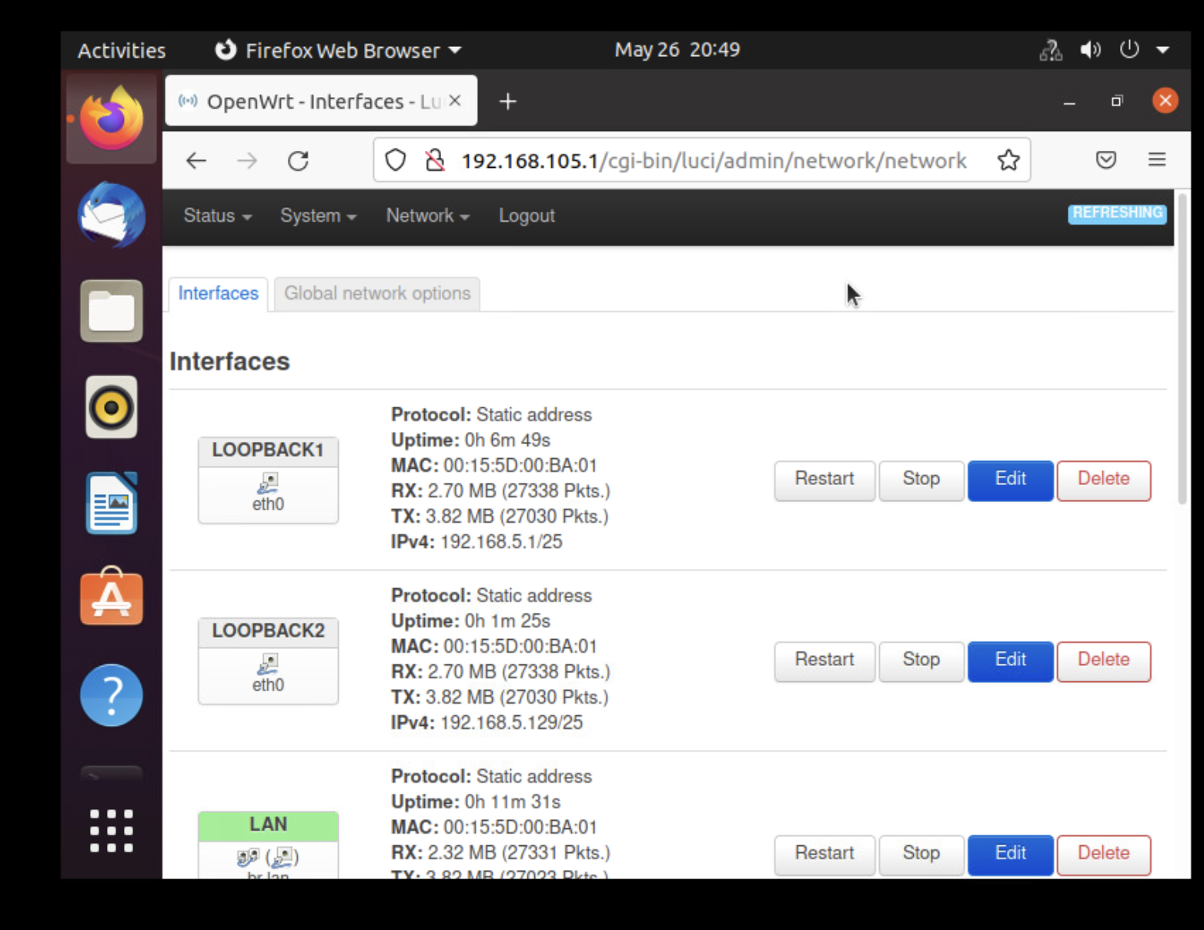
Loopback Interfaces
This screenshot should show both Loopback1 and Loopback2 interfaces and their correct IPv4 addresses.
This screenshot should also show the date/time information on top of the desktop window.

Slide 19
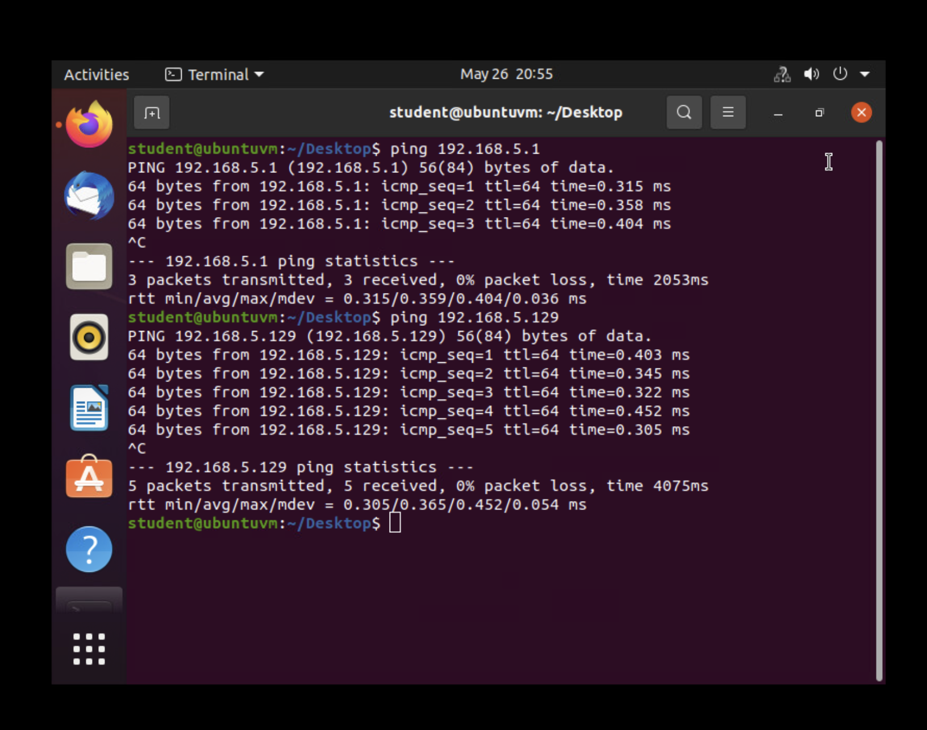
Connectivity Tests
This screenshot should show two successful ping tests:
from the Computer 1 VM to the Loopback 1 interface
from the Computer 1 VM to the Loopback 2 interface
This screenshot should also show the date/time information on top of the desktop window.

Slide 20
Conclusions:
Project: The project involved dividing a class C network into smaller subnets to create two LAN segments and configuring Loopback interfaces on a SOHO Router to simulate the LAN segments.
Module: In this module, we learned about subnetting, IP addressing, and network segmentation. We gained practical experience in setting up virtual LANs and configuring network devices.
Conclusions: By completing this project, we were able to successfully create two LAN segments within the network and configure Loopback interfaces on the SOHO Router. This exercise helped us understand the importance of subnetting and network segmentation in efficient network management.
Technical Challenges Faced: One of the main technical challenges faced was accurately dividing the IP address block into smaller subnets and configuring the Loopback interfaces with the correct IP addresses. Troubleshooting connectivity issues and ensuring proper routing between the LAN segments were also challenging tasks.
Career Skills Gained: Through this project, we developed skills in subnetting, IP addressing, network segmentation, and network device configuration. These skills are highly valuable in the field of network administration and can be applied to real-world networking scenarios. This project also helped improve our troubleshooting abilities and understanding of network architecture.

Slide 21
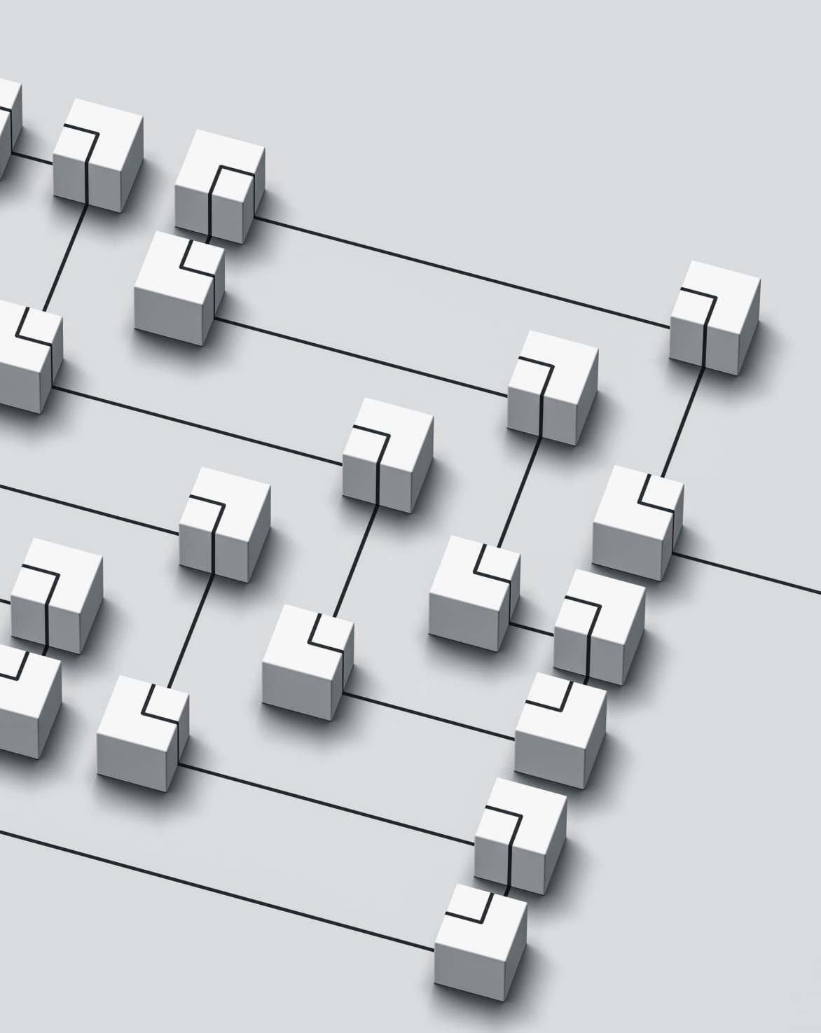
NETW191 Course Project Module 5 Visio Network Diagram

Slide 22
Introduction
In this project, I use Microsoft Visio to create a network diagram that illustrates the interconnection of 3 virtual machines: Computer 1, Computer 2, and SOHO Router. The network diagram will showcase how these virtual machines are connected to each other within a virtual network environment.
Major steps include:
creating a new network diagram in Microsoft Visio
using appropriate icons
connecting the icons using the proper interconnection lines
accurate labeling
layout organization
details such as IP addresses, subnet masks, and the like.

Slide 23
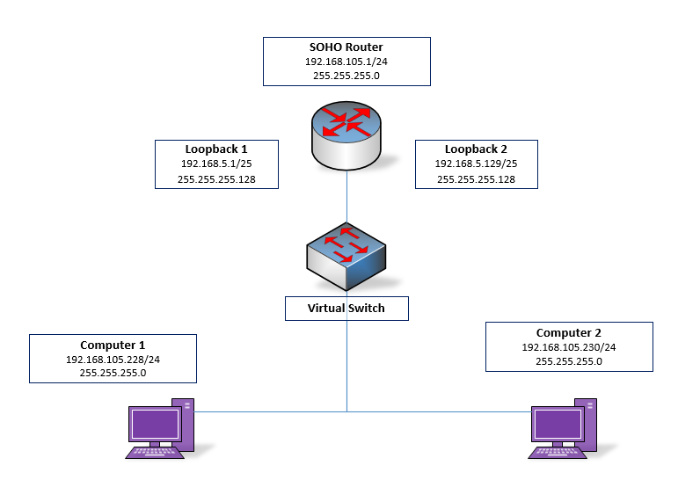
Microsoft Visio Network Diagram
This diagram should illustrate the interconnection of the Computer 1 VM, the Computer 2 VM, and the SOHO Router VM along with proper IP addresses and labeling.
AJ

Slide 24
Conclusions
In this project module, I utilized Microsoft Visio to create a network diagram showcasing the interconnection of three virtual machines: Computer 1 VM, Computer 2 VM, and SOHO Router VM within a virtual network environment. By following the outlined steps, I successfully represented the network topology and connections between the virtual machines, ensuring clarity and accuracy in the diagram.
Key Conclusions:
The project module allowed you to demonstrate your ability to create network diagrams using software tools like Microsoft Visio.
By visualizing the network configuration, you gained a better understanding of how virtual machines are interconnected within a network environment.
Technical Challenges Faced:
Selecting appropriate icons for virtual machines and routers that accurately represent them in a virtual environment.
Ensuring that the interconnections between the virtual machines and router were correctly depicted in the diagram.
Properly labeling and organizing the network diagram to enhance clarity and understanding.
Career Skills Gained:
Proficiency in using Microsoft Visio to create network diagrams, a valuable skill in roles related to network administration, system administration, or IT project management.
Enhanced ability to communicate complex network configurations visually, which is crucial in presenting technical information to stakeholders or team members.
Improved attention to detail and problem-solving skills through overcoming technical challenges faced during the project module.

Slide 25
NETW191 Course Project Module 6 SOHO Wireless Network Security

Slide 26
Introduction
During this project, we delve into enhancing the protection of a small office or home office LAN through router configurations. This project focuses on securing wireless network connections, which are prevalent in most home setups. Throughout the module, we explored key steps to bolster network security, such as changing default credentials, enabling encryption, setting up MAC address filtering, and updating firmware. By implementing these configurations, we aim to fortify the network against potential threats and unauthorized access, ensuring a safer and more secure wireless environment for home or small office users.

Slide 27
SOHO Wireless Network Security 1 of 3
1. What are the factory default username and password of a TP-Link router? Why is it important to change the default username and password of a SOHO router?
Answer: admin / admin – Changing the default username and password on your SOHO router is a simple but effective way to enhance your network's security and protect your data from public knowledge.
2. To protect a SOHO wireless network with a small number of devices, which address management method provides more control, configuring the device IP addresses manually (static IP) or using a DHCP server (dynamic IP)? Why?
Answer: For a SOHO wireless network with a small number of devices, configuring IP addresses manually (static IP) offers more control. Static IPs ensure each device always has the same address, making network management and security measures more predictable and precise. You can easily monitor activity, set specific firewall rules, and reduce the risk of unauthorized access. While DHCP simplifies setup by automatically assigning IPs, it lacks the granular control that static IPs provide.

Slide 28
SOHO Wireless Network Security 2 of 3
3. What does MAC filtering do? If needed, when would you use deny filtering rules and when would you use allow filtering rules? What happens to devices that want to connect, if the “Allow the stations specified by any enabled entries in the list to access” function is enabled but there are no entries in the list?
Answer: MAC filtering is a security feature on a router that controls which devices can connect to the network based on their Media Access Control (MAC) addresses. When using deny filtering rules, you block specific devices from accessing the network, usefor for preventing unauthorized or problematic devices. On the other hand, allow filtering rules only permit devices with specified MAC address to connect, ensuring a more exclusive network access. If the "Allow the stations specified by any enabled entries in the list to access" function is enabled but no entries are in the list, devices attempting to connect will be denied access as there are no approved MAC addresses for connection.
4. What wireless security settings are displayed on the Wireless Security page? Which one is recommended by the vendor? Why?
Answer: On the wireless security page, you typically see settings such as encryption methods (WEP, WPA, WPA2), security key/password settings, and possibly options for MAC address filtering and SSID broadcasting. Vendors often recommend using WPA2 encryption as it offers the highest level of security among the common encryption methods. WPA2 provides robust encryption to protect your network from unauthorized access and cyber threats, making it the preferred choice for securing wireless networks.

Slide 29
SOHO Wireless Network Security 3 of 3
5. Among the configurations you explored in this module, which one is a true security function? Why?
Answer: MAC address filtering stands out as a true security function. MAC address filtering allows you to control which devices can connect to your network based on their unique MAC addresses, adding an extra layer of security beyond just passwords. By explicitly permitting or denying specific devices, you can enhance network protection against unauthorized access and potential threats. This feature helps in safeguarding your network and ensuring that only trusted devices can connect, making MAC address filtering a valuable security measure in securing your SOHO wireless network.
6. What would you do to protect your wireless network at home? Why?
Answer: I would start by changing the default username and password of my router to prevent unauthorized access. Next, I would enable WPA2 encryption to secure my network traffic and ensure that only authorized devices can connect. Additionally, I would regularly update the firmware of my router to patch any known security vulnerabilities and keep my network protected. These steps help in safeguarding my home wireless network from potential threats and unauthorized intrusions.

Slide 30
Conclusions
In the SOHO Wireless Network Security project module, we concluded that implementing security configurations on a small office or home office LAN is crucial for safeguarding network integrity. The technical challenges faced included configuring router settings like MAC address filtering and encryption to enhance network protection.
Through this project, we gained valuable career skills in network security management, router configuration, and troubleshooting, equipping us with the expertise to secure wireless networks effectively. By overcoming these challenges and implementing robust security measures, we are better prepared to protect our digital assets and ensure a safe and secure network environment.

Slide 31
References
Live weekly session, Cangage Mindtap reading

